Slide 1
Analysing Amazon Movie Reviews
Data Science IN Techno-Socio-Economic Systems
By Ferdinand Brunne, Oliver King, Brian Funk, and Silvan Metzker
Notes:
Hello everyone: Waiting forever for an elevator.

Slide 2


Motivation: Review Helpfulness Problem (RHP)
Understanding which Reviews are Helpful
Display Positive Helpful Reviews
Display Negative Helpful Reviews
Helps Convince Consumer to buy Product
Alerts Customer of Valid Issues with Product
Notes:
In our fast-paced modern world, one of a company’s top priorities must be to understand their consumers on a fundamental level. By doing so, they can advertise products and service that they know the consumer will take an interest in. However, one of the largest gaps in understanding consumers that companies face today is the presence of user reviews.
User reviews for products are often the dominant factor in making or breaking a sale, and it can be incredibly difficult to anticipate how users will react to said reviews when they read them – this issue is termed the Review Helpfulness Problem (RHP). If the company can figure out which reviews a user will consider helpful, not only can reviews be shown to positively influence the chance of a sale, but reviews discussing valid issues with a product can be displayed to alert the consumers before they buy.

Slide 3
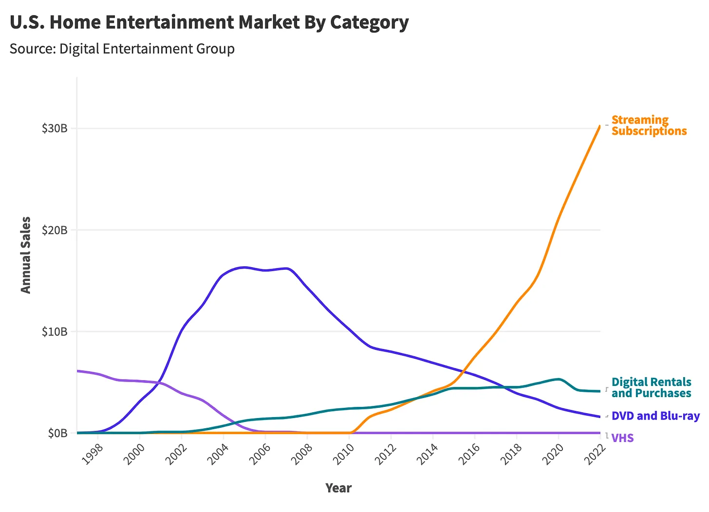
Motivation: Amazon Movie Reviews
Movies are of interest to the vast majority of people
A large amount of RHP research has already been done on movie reviews [1]
Largest Online Retailer: Word Record set in 2024, over $400 billion in annual sales [2]
Almost every movie in the world can be found on Amazon
Movie Sales across Formats in the U.S.A. [3]
Notes:
In our project, we chose to use movie reviews to investigate the RHP. Specifically, movie reviews of physical DVD sales on Amazon.com. Not only does a large amount of research into the RHP already investigate movie reviews, giving us results to compare our findings with, but movies are a universal experience: almost everybody watches movies, and thus our project has minimal selection bias.
We chose Amazon as our data source for multiple reasons: first off, it is an enormous online marketplace, that attracts all kinds of people (it has recently gained the world record for the largest online retailer). This, again, minimizes our selection bias. It also contains a huge variety of movies, with almost every movie made in the last 40 years sold on it. Whilst physical DVD sales are currently on the decline, we investigated a dataset from 1997 to 2012, when physical DVD sales were in their heyday.

Slide 4
Can we use a variety of Methods (ML, NN, and statistical models) to Predict the Helpfulness of Amazon Movie Reviews?
HYPOTHESIS
Notes:
Our hypothesis ^
Main research questions:
If we can, to what degree can we predict it?
Which model is best?
How do our results compare to previous research?

Slide 5
Literature Review
An overview

Slide 6



Literature review
Timeline of approaches
2006
2011
2022
Classical Machine Learning with SVM
Sentiment Features
Transformer-Based Models (BERT)
“Automatically Assessing Review Helpfulness”
“Estimating the Helpfulness and Economic Impact of Product Reviews: Mining Text and Reviewer Characteristics”
“Effectiveness of Fine-tuned BERT Model in Classification of Helpful and Unhelpful Online Customer Reviews”

Slide 7
Machine Learning with SVM 2006
Automatically Assessing Review Helpfulness (KIM et al.) [5]00
2006
First to approach the challenge
SVM-based regression
2011
Structural, lexical, syntactic, semantic and meta-data as features
2022
Spearman correlation of 0.66

Slide 8
sentiment Features 2011
Estimating the Helpfulness and Economic Impact of Product Reviews: Mining Text and Reviewer Characteristics (Ghose et al.) [6]
2006
Random Forst Classifiers for predicting helpfulness
Introduced new sentiment features for analysis: subjectivity & positivity
2011
2022

Slide 9
Attention based models 2022
Effectiveness of Fine-tuned BERT Model in Classification of Helpful and Unhelpful Online Customer Reviews (bilal et al.) [7]
2006
Using transformer architecture that only takes text as input
Part of larger shift towards using BERT for sentiment analysis
2011
Showed that this approach could outperform pervious approaches
2022

Slide 10
Dataset
Our approach
Notes:
Maybe add feature discussion to datasets

Slide 11

Dataset
Web Data: Amazon Movie Reviews. Contains 7,911,684 total reviews. Collected from August 1997 to October 2012. [4]
Notes:
Collected from August 1997 to October 2012
Nearly 8 million total reviews, each with some number of helpfulness markers.

Slide 12
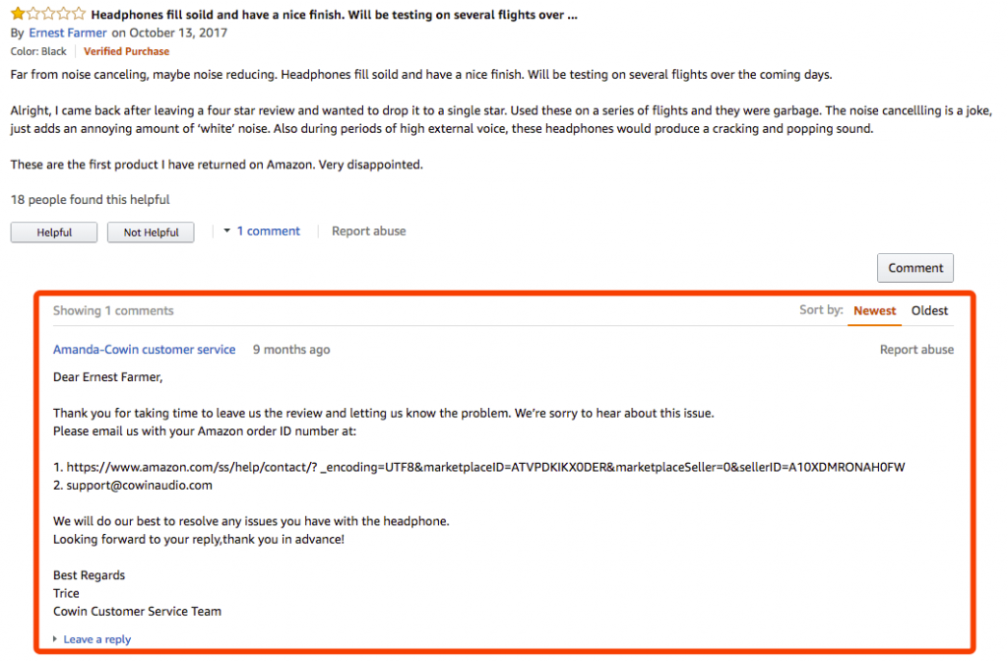
Dataset
Notes:
- Helpfulness marker for not helpful removed after October 2012.

Slide 13
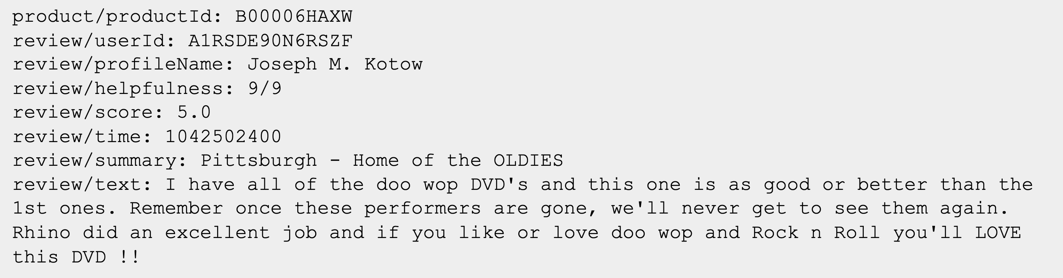
Relevant to us: Review/Helpfulness, Review/Score, Review/Summary, Review/Text.
Notes:
Talk about each element of the dataset.
Mention: Helpfulness = Helpful / (Helpful + Not Helpful)

Slide 14
Dataset: Cut data
7,911,684 Entries
Original Dataset
Cut: < 3 Characters, < 2 Helpful + Not Helpful, Errors
4,574,518 Entries
Cut Dataset
Cut: < 20 Helpful + Not Helpful
463,236 Entries
“Certain 20” Dataset
Notes:
To utilise our dataset in the most effective way possible, we had to first make some cuts to it. We removed any data with less than three characters in the combined review summary and review text, as that would not constitute a good review. Furthermore, we removed any data with less than 2 helpfulness markers – with 0 markers, we could not compare our prediction, and since both the seller and the review-writer can mark reviews as helpful (the writer from a second account) we chose to remove data with only one marker as well.
We knew that we would get more accurate results if we further restricted the number of markers. However, we would then be removing a significant subset of the data. To investigate this, we created a second dataset, with only reviews with greater than 20 helpfulness markers in it. We labelled this Certain 20.
We also defined a Helpfulness fraction, as seen here.

Slide 15
Dataset: Explanatory Data Analysis (EDA)
 | Rating | Word Count | Log(Word Count) | Helpfulness
Normality p | 0 | 0 | 0 | 0
Spearman's | 0.319655607 | 0.26753133 | 0.26753133 | N/A
Spearman's p | 0 | 0 | 0 | N/A
Average | 3.855191957 | 239.8625407 | 5.048032972 | 0.623933606
Std. Dev. | 1.414071519 | 249.3789082 | 0.95199141 | 0.324989332
Weighted Av. | 3.796418505 | 379.8200473 | 5.535315764 | 0.743331321
W Std. Dev. | 1.554992361 | 368.8492116 | 0.958509263 | 0.342620396
Notes:
Did an EDA for the full dataset
Data not normally distributed: used Spearman’s Rho instead of Pearson’s R for WC / rating against helpfulness, and measured monotonicity
Also checked: normality, Average, std, weighted av, weighted std (will explain weighting later)
Data is not normally distributed, and contains an incredible number of outliers
P Values: for normality, is probability of rejecting null hypothesis, that data is normally distributed
For Pearson’s, is probability of rejecting null hypothesis, that data is non-monotonic

Slide 16
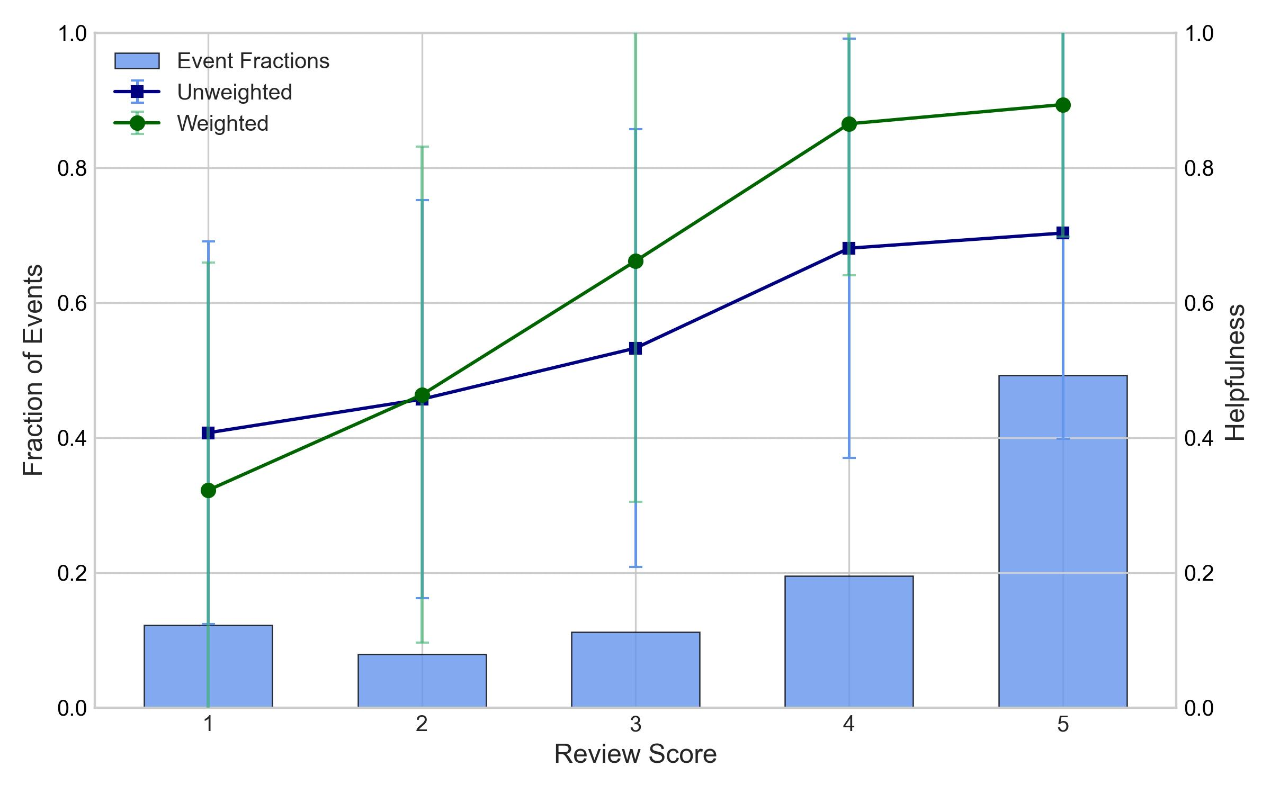
Dataset: EDA: rating
Notes:
Histogram for proportion of events at each value (left)
Lines for average helpfulness at each value (right)
Error bars: 1 STD distribution of data points around the mean: shows lots of outliers
Weighting will be explained later

Slide 17
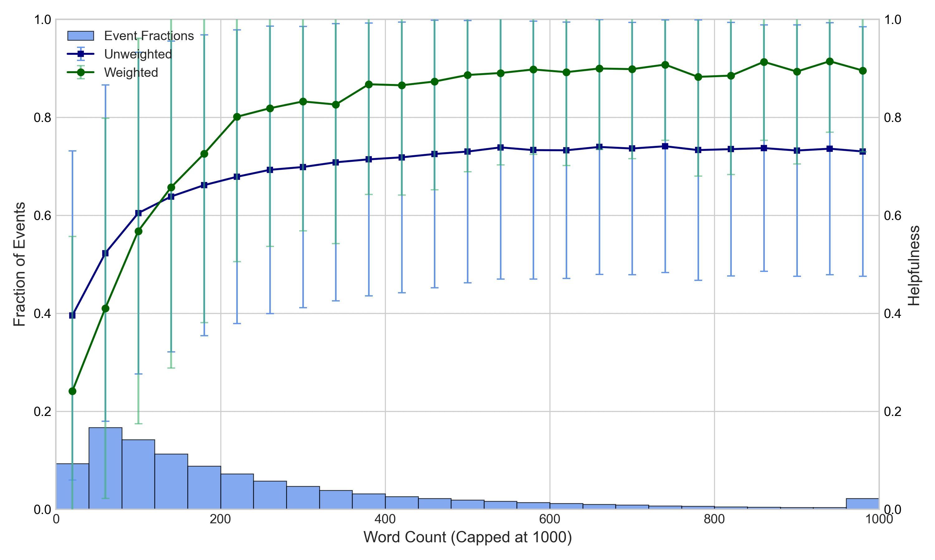
Dataset: EDA: Word Count
Notes:
- Works same as for rating, only now bins are arbitrary, and a cap has been placed at 1000 for visualisation purposes

Slide 18
Data Augmentation
Our Approach

Slide 19
VADER
Method
“terrible” = -2.1
”not great” = -3.1
“!” or “very”
“great” = 3.1
Degree
Modifiers
Word Scoring
Negations

Slide 20
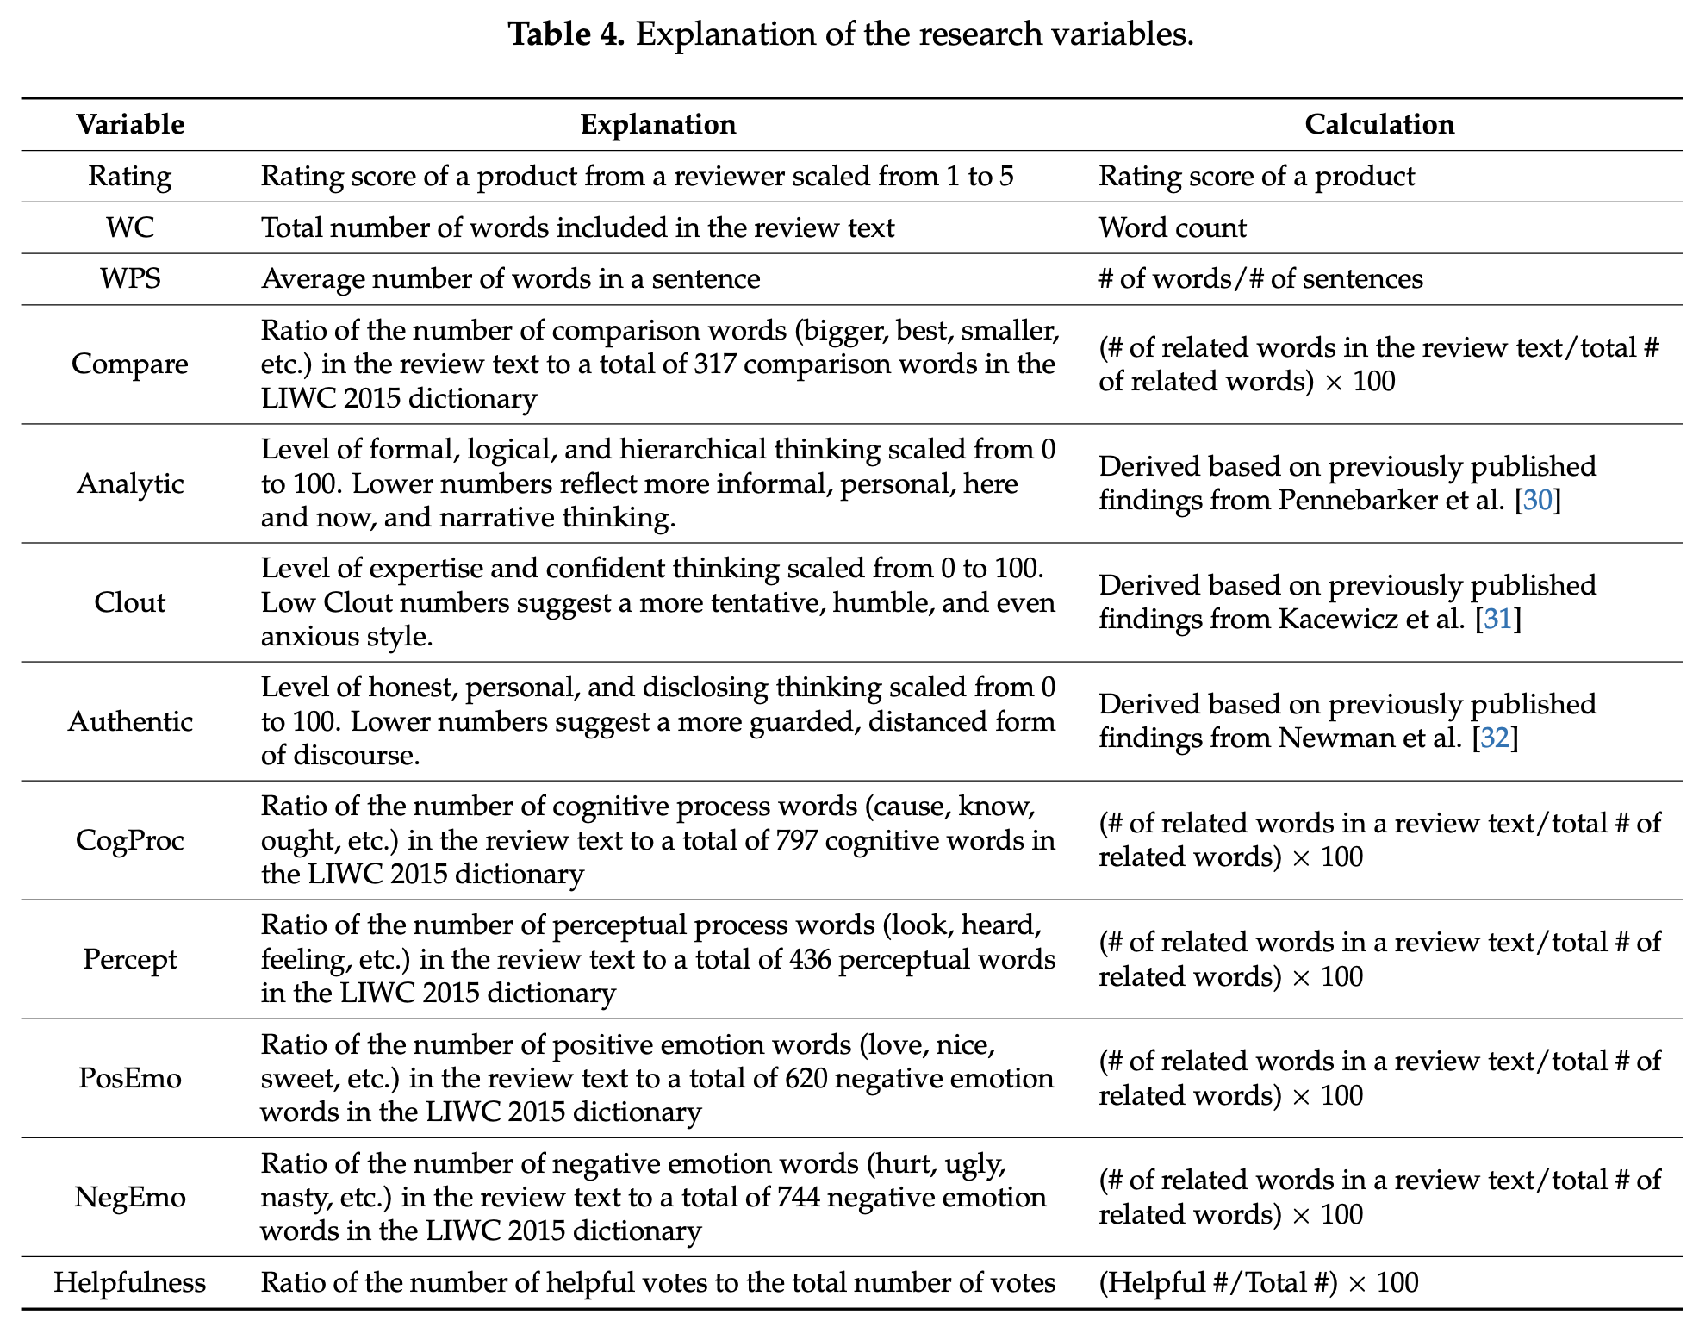
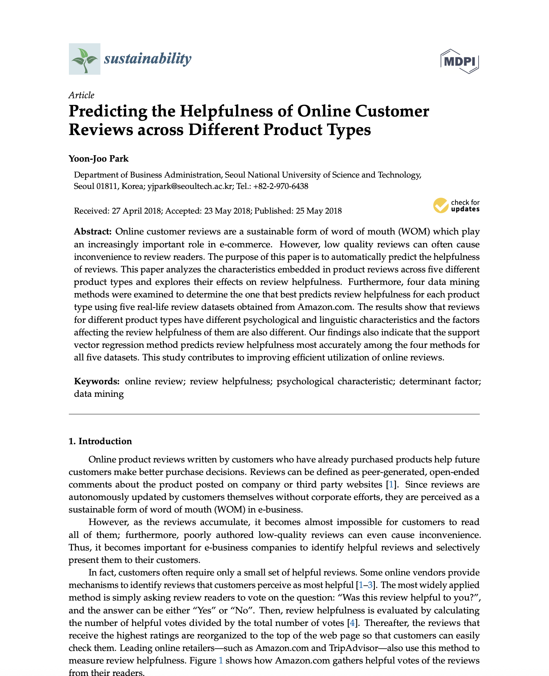
Empath
Method
https://www.mdpi.com/2071-1050/10/6/1735

Slide 21
Our metrics
Method
Rating: Product rating score received from a reviewer.
WC: The length of a review measured by the number of words in the review text (Word Count).
Analytic: The level of formal, logical, and hierarchical thinking.
Sentiment Score: VADER Score estimating sentiment [-1,1].
FleschKincaid Score: Readability metric that indicates how easy a text is to understand.
https://www.mdpi.com/2071-1050/10/6/1735

Slide 22
Our models
Our Approach

Slide 23
Quantile Regression
XGBoost
Neural Networks
BERT
Comparison

Slide 24




Weightings for Statistical Models
$$H=\frac{H^{+}}{H^{+}+H^{−}}$$
Laplace Smoothing
$$H=\frac{H^{+}+1}{H^{+}+H^{−}+2}$$
Helpfulness in Standard Error
$$SE=\sqrt{\frac{H\left(1−H\right)}{n}}$$
$$w=\frac{1}{SE^{2}}$$
Standard Error
Weight
Notes:
- Mention treating helpful / not helpful as binomial counts

Slide 25




Error Measure
$$MSE=\frac{\sum_{i=1}^{n}{{\left(H_{i}−{\hat{H}}_{i}\right)}^{2}}}{n}$$
$$MAE=\frac{\sum_{i=1}^{n}{\left|H_{i}−{\hat{H}}_{i}\right|}}{n}$$
Mean absolute Error
Mean squared Error
$$WMSE=\frac{\sum_{i=1}^{n}{w_{i}{\left(H_{i}−{\hat{H}}_{i}\right)}^{2}}}{\sum_{i=1}^{n}{w_{i}}}$$
$$WMAE=\frac{\sum_{i=1}^{n}{w_{i}\left|H_{i}−{\hat{H}}_{i}\right|}}{\sum_{i=1}^{n}{w_{i}}}$$
Weighted Mean absolute Error
Weighted Mean Square Error

Slide 26

Quantile Regression
Setup
Quantile Regression Model run ten times, results are average and standard deviation of these runs
$$H=\frac{1}{1+e^{− \frac{H^{′}}{1.25}}}$$
Quantile Regression intentionally did not have its loss completely minimised, to avoid overfitting at edges (explained later)
Took a Weighted Approach
Flexible Sigmoid
Each input parameter was mean-centred, except Word Count which was logged, and a flexible sigmoid was applied to the results for better fitting

Slide 27
Quantile regression
Method
Estimates the conditional quantile: for a quantile of 0.5, this is the median
Minimises Weighted Quantile Loss: we chose a quantile of 0.5, it becomes exactly half the Weighted MAE
Does not rely on assumption of linearity, unlike linear regression

Slide 28
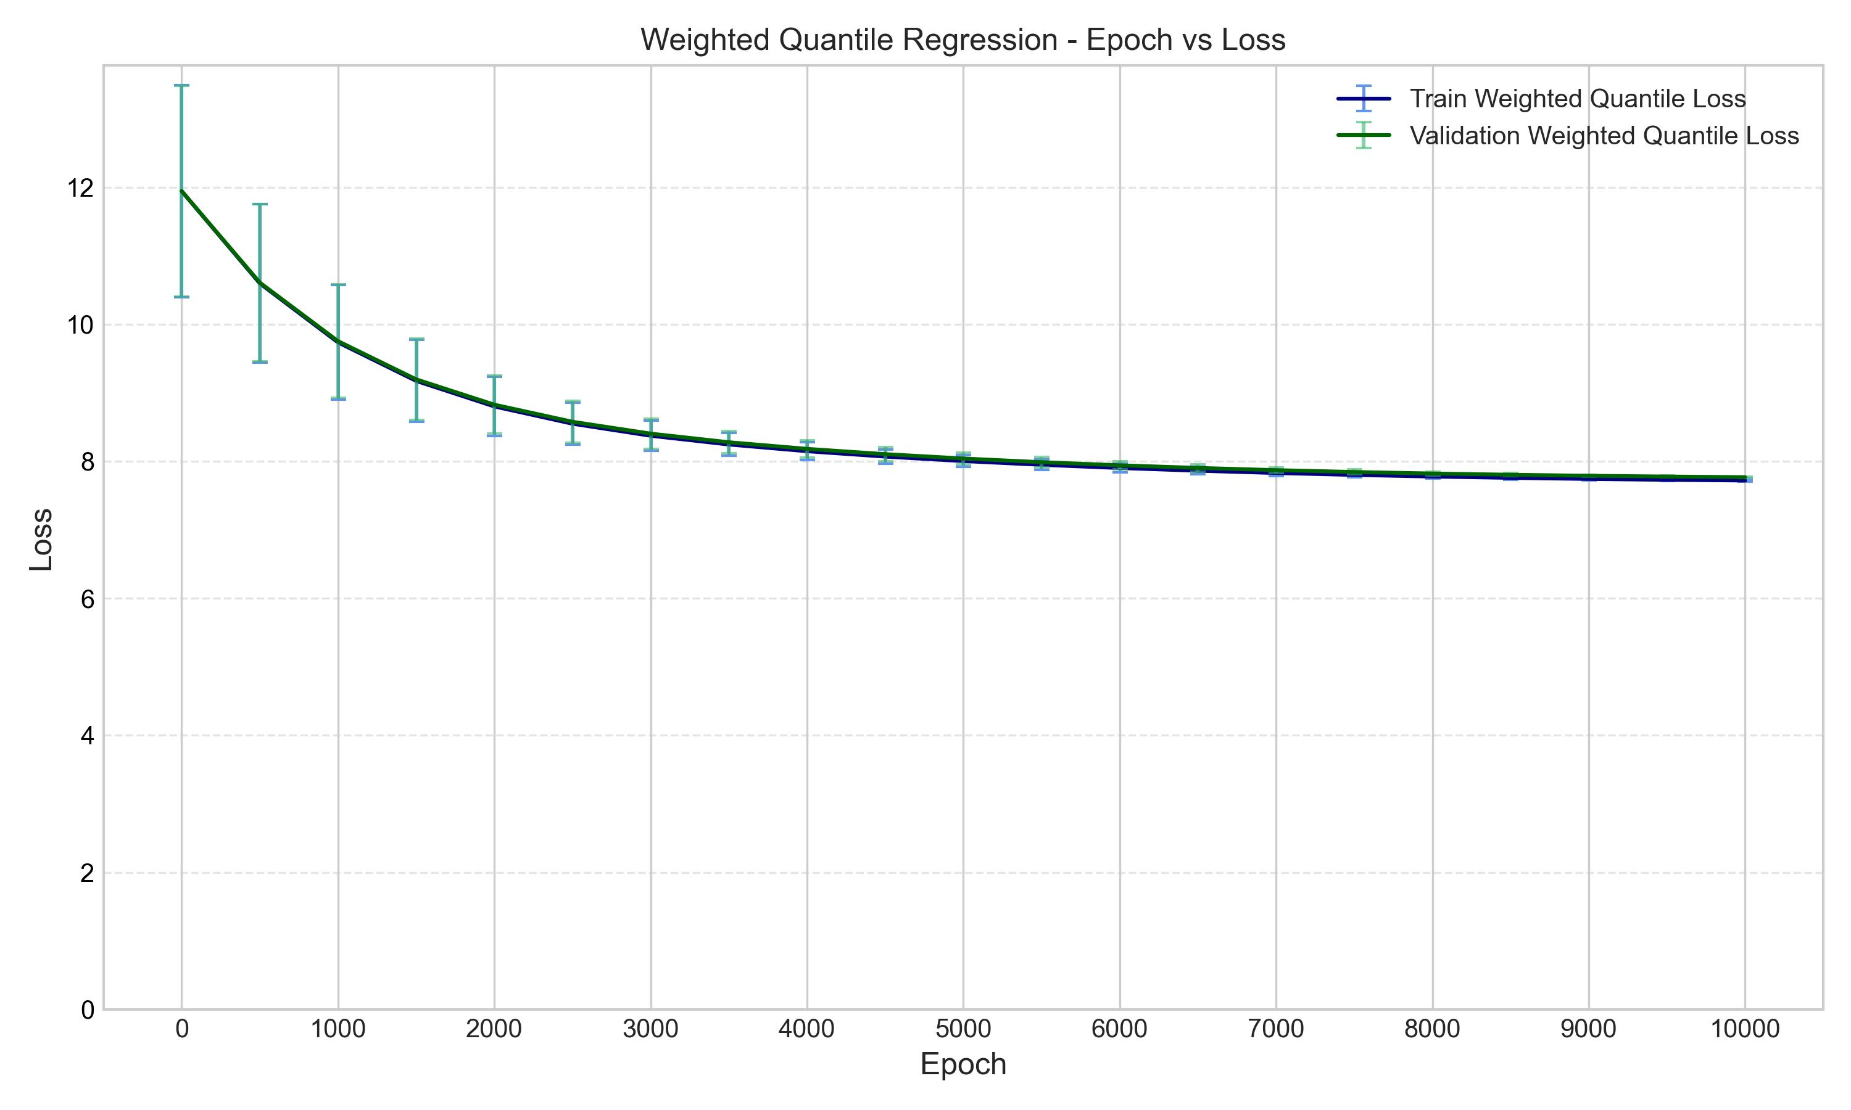
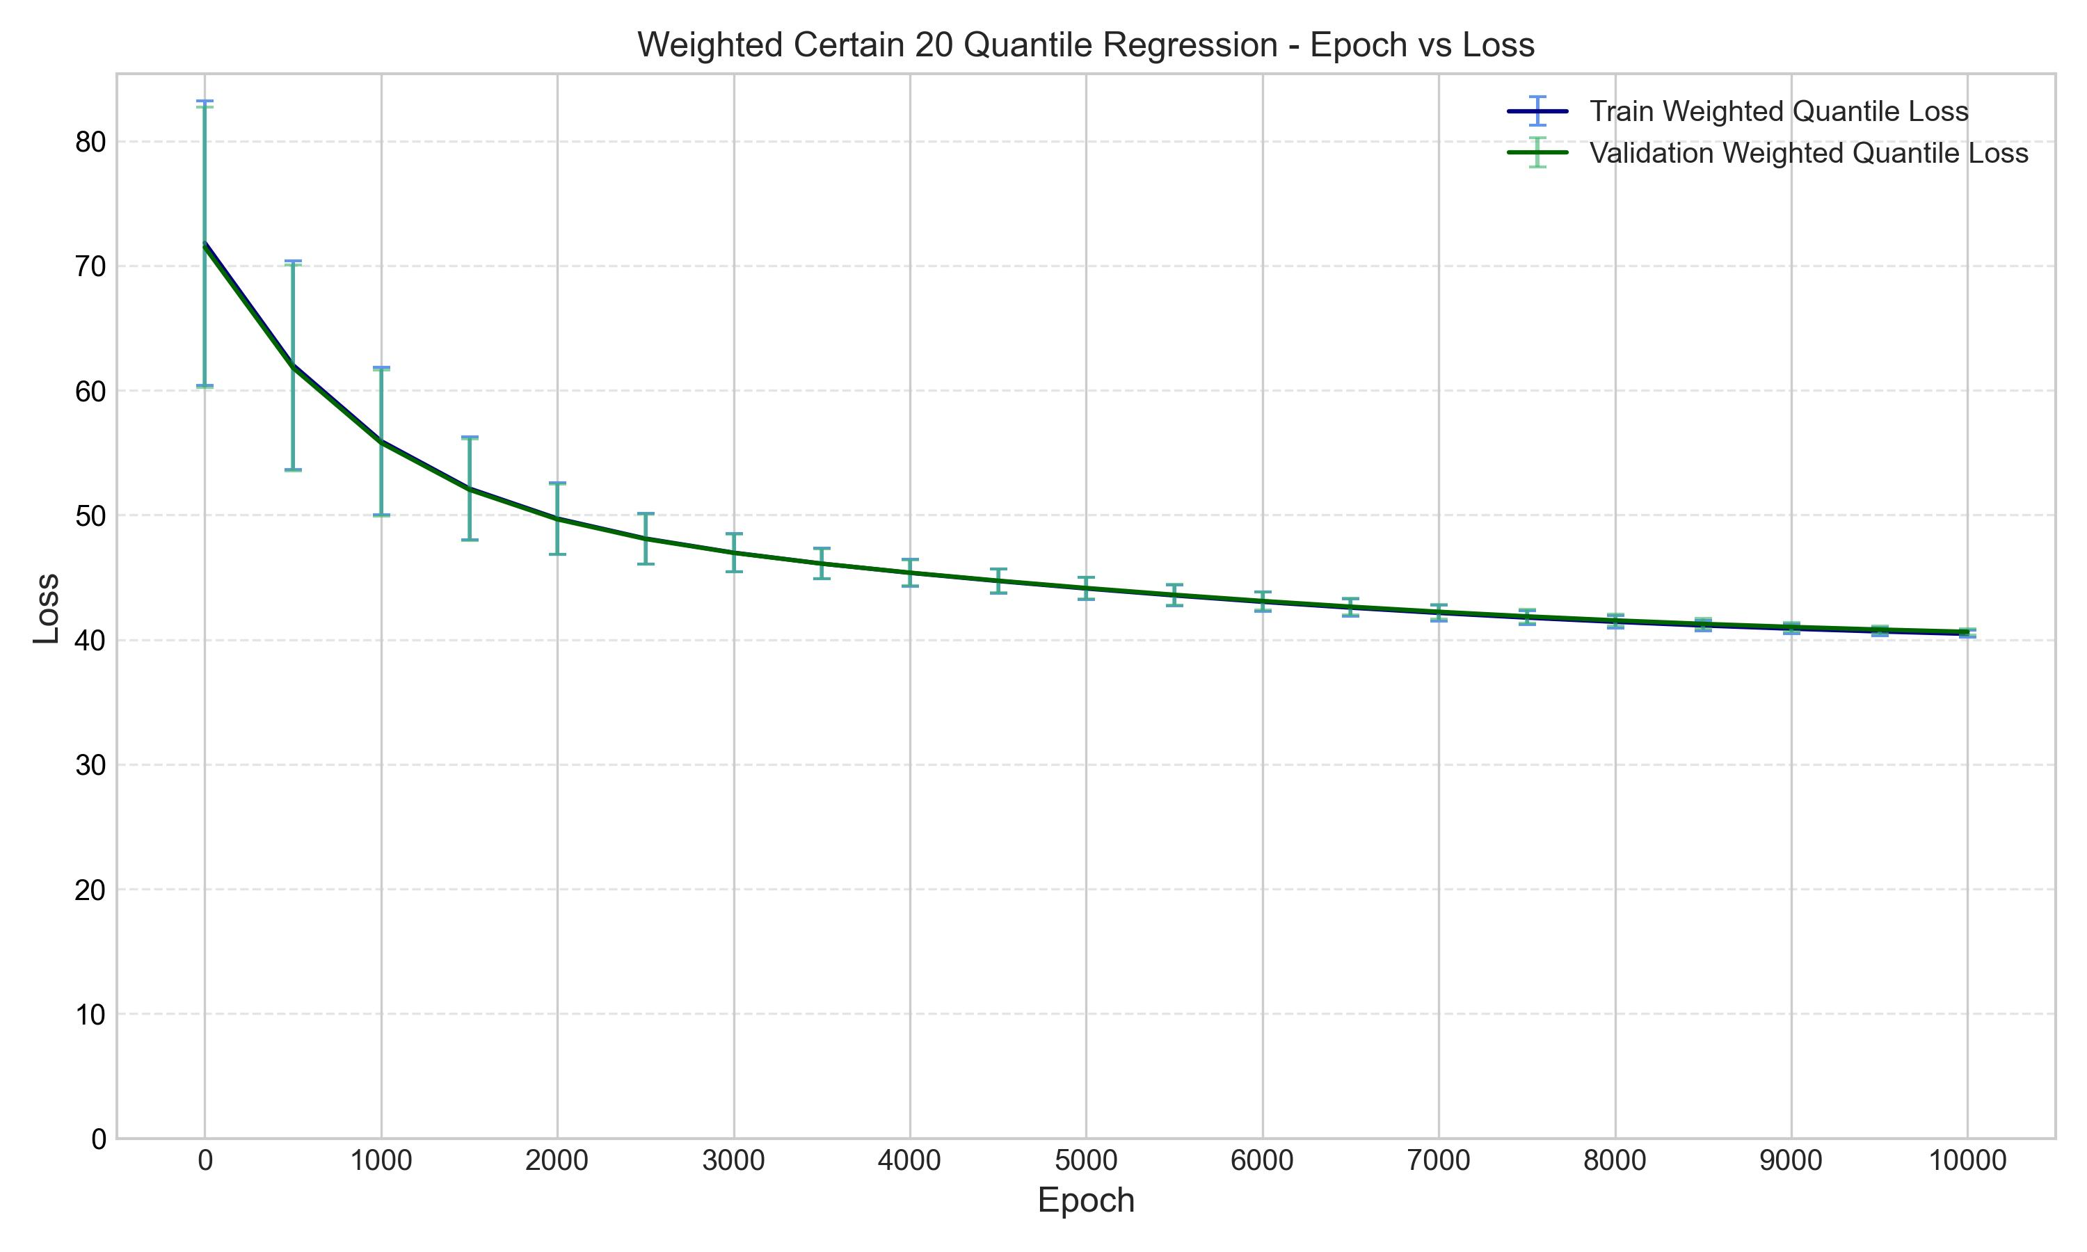
QUANTILE REGRESSION
RESULTS

Slide 29
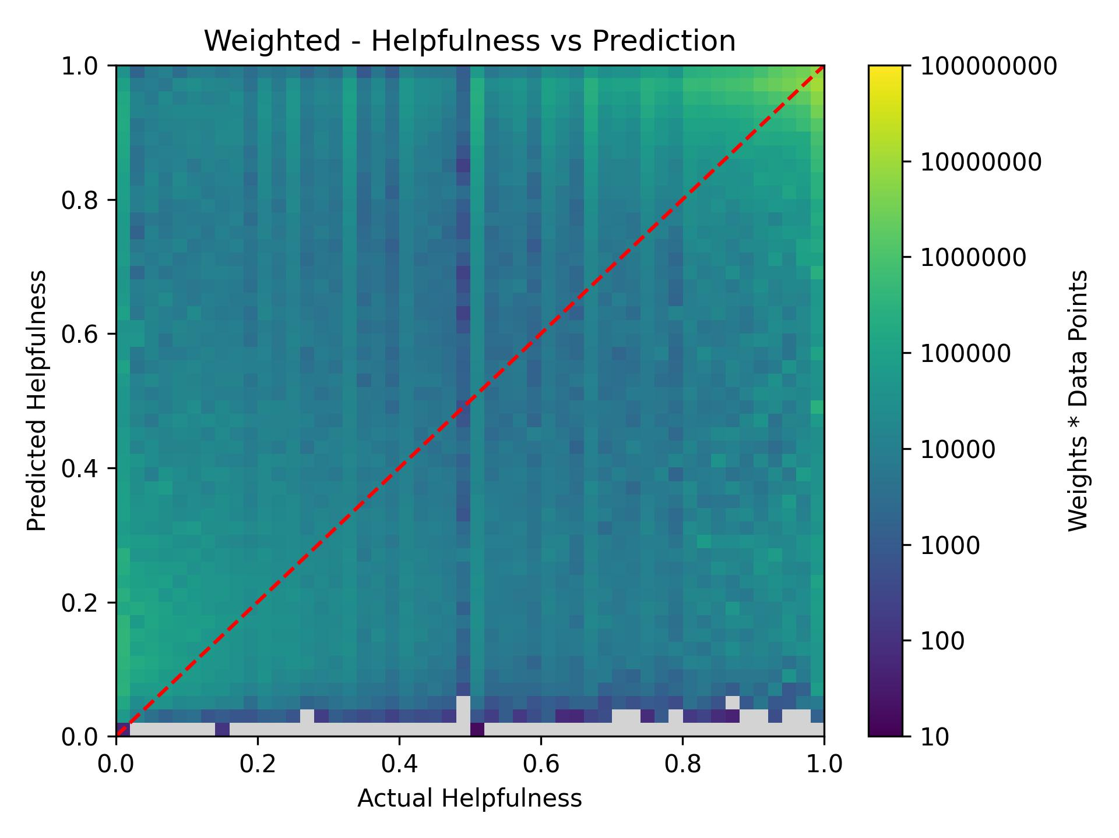
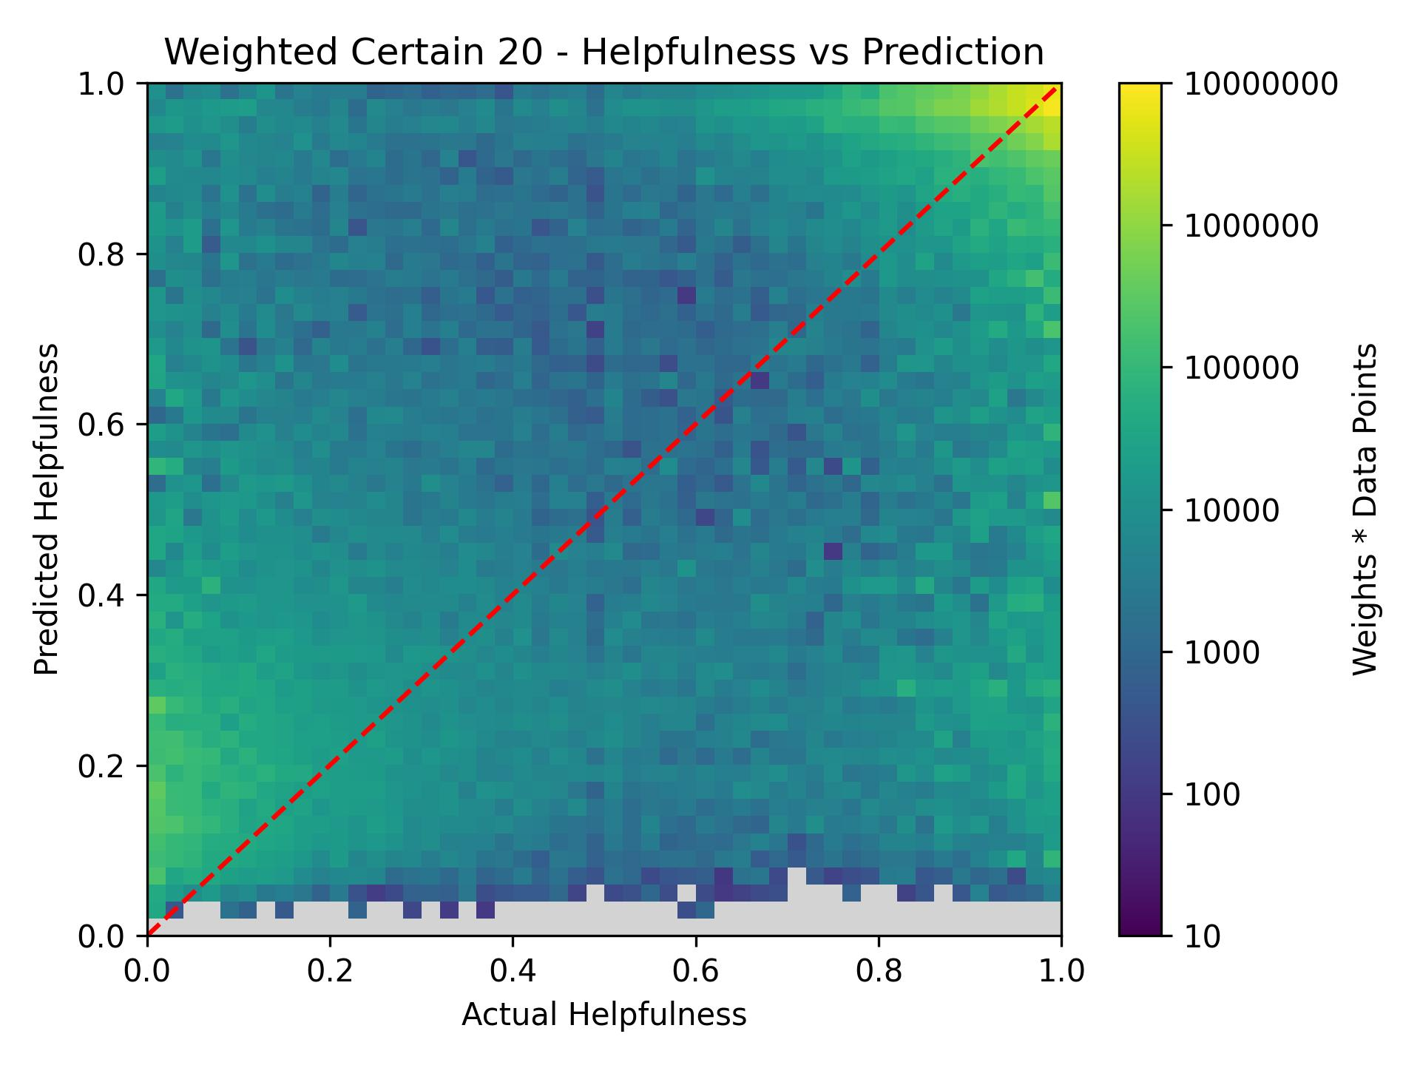
QUANTILE REGRESSION
RESULTS

Slide 30



QUANTILE REGRESSION
* : These values are Mean-Centred
RESULTS
$$y^{′}=\text{Helpfulness} \left(\text{Pre}\text{−}\text{Sigmoid}\right)$$
$$x_{1}=\text{Log}\left(\text{Word} \text{Count}\right)$$
$$x_{2}=\text{Sentiment} \text{Scor}{\text{e}}^{\text{∗}}$$
$$x_{3}=\text{User} \text{Scor}{\text{e}}^{\text{∗}}$$
$$x_{4}=\text{Analytic} \text{Scor}{\text{e}}^{\text{∗}}$$
$$x_{5}=\text{Readability} \text{Scor}{\text{e}}^{\text{∗}}$$
$$c=1$$
$$y′=\left(0.462±0.018\right)x_{1}+\left(1.38±0.05\right)x_{2} \\ + \left(1.26±0.04\right)x_{3}+\left(0.62±0.04\right)x_{4} \\ + \left(0.156±0.004\right)x_{5}−\left(0.08±0.08\right)c$$
$$y′=\left(0.360±0.016\right)x_{1}+\left(1.41±0.06\right)x_{2} \\ + \left(1.30±0.06\right)x_{3}+\left(0.53±0.06\right)x_{4} \\ + \left(0.162±0.008\right)x_{5}−\left(0.22±0.07\right)c$$
Full Dataset
Certain 20
Notes:
- Models followed by Quantile Regression

Slide 31
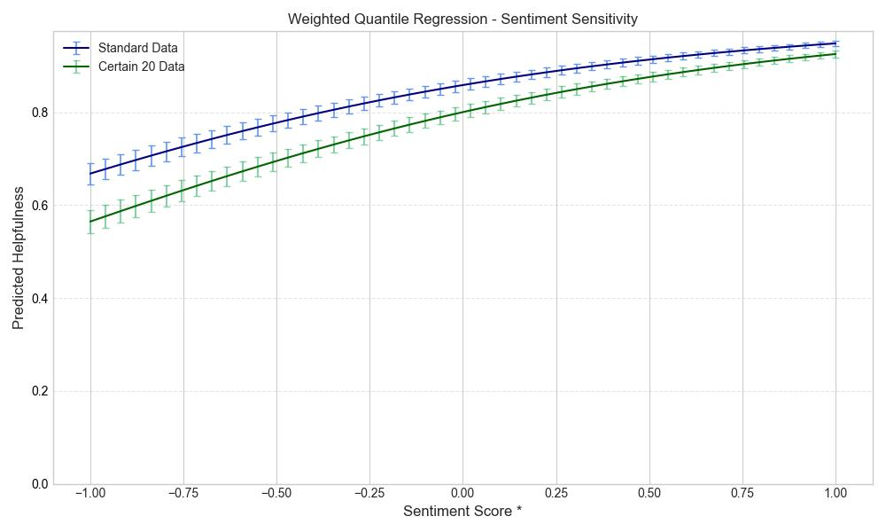
QUANTILE REGRESSION
Sensitivity Analysis
Notes:
This was the x with the largest sensitivity change
* Means data is Mean-Centred

Slide 32
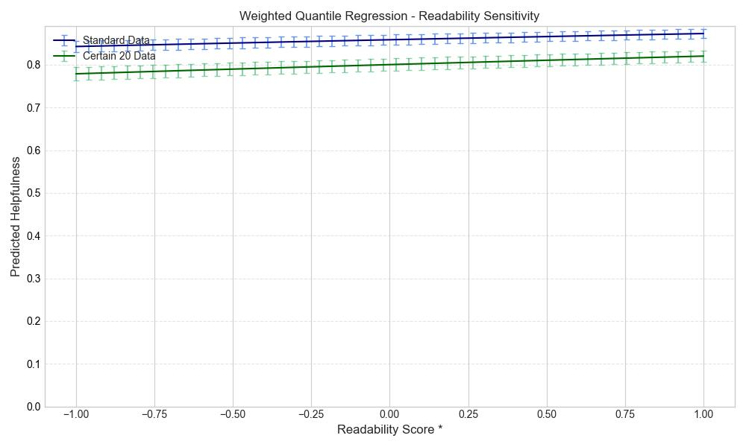
QUANTILE REGRESSION
Sensitivity Analysis
Notes:
This had very little change with sensitivity

Slide 33
Full Dataset
Results
Notes:
- Quantile Regression does not aim to minimise MSE or MAE, however they are displayed here for model comparison

Slide 34
Certain twenty
Results

Slide 35
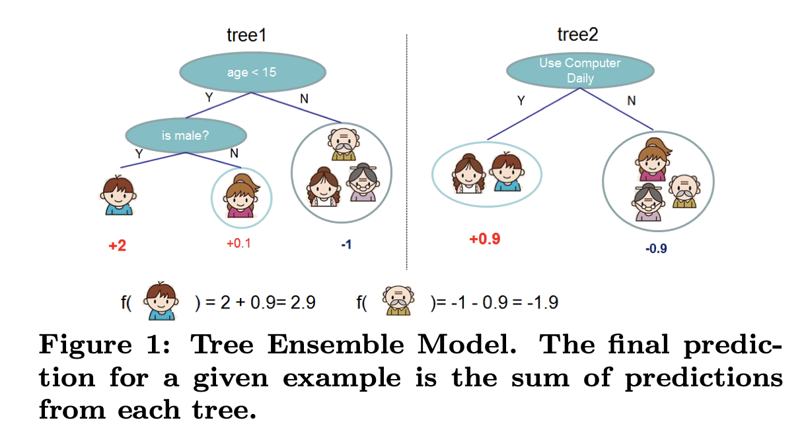
Xgboost
Method
https://arxiv.org/abs/1603.02754 [8]

Slide 36
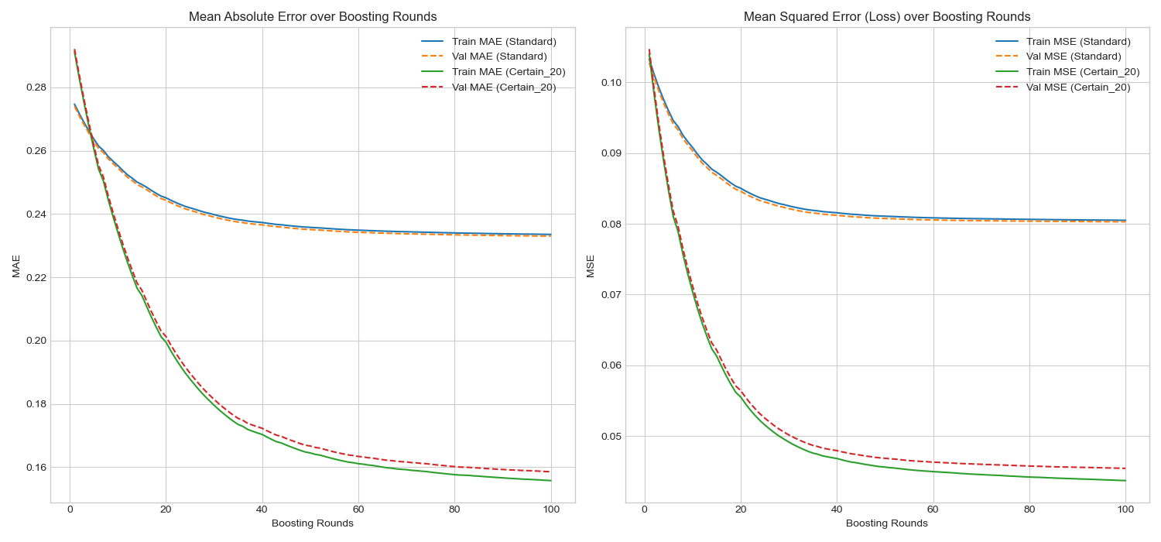
XGBOOST
RESULTS

Slide 37
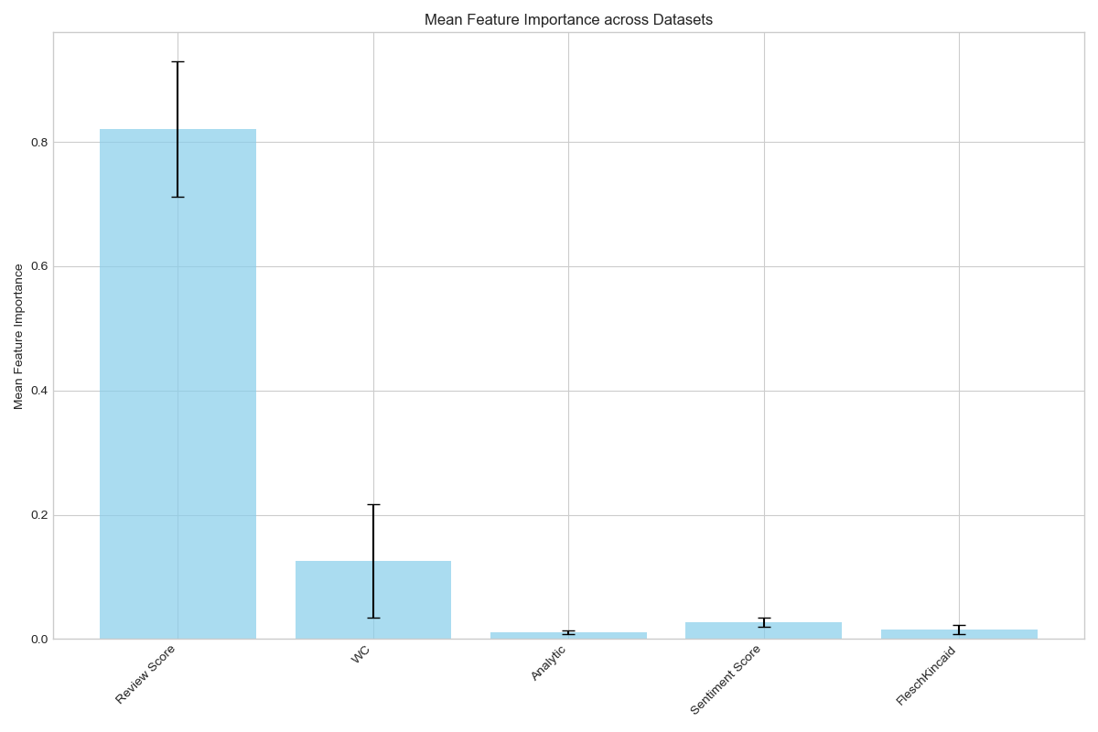
XGBOOST
Results

Slide 38
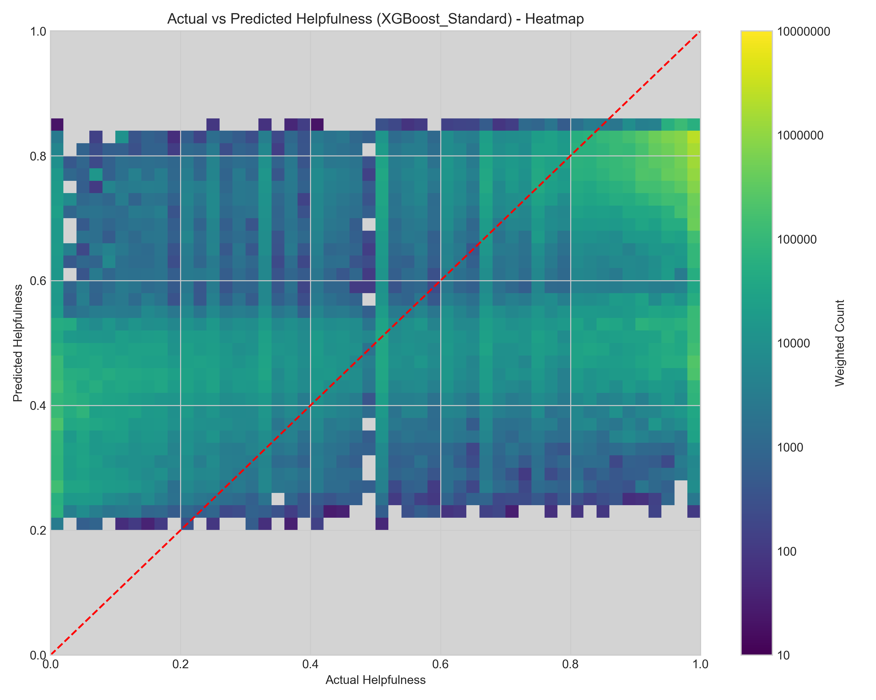
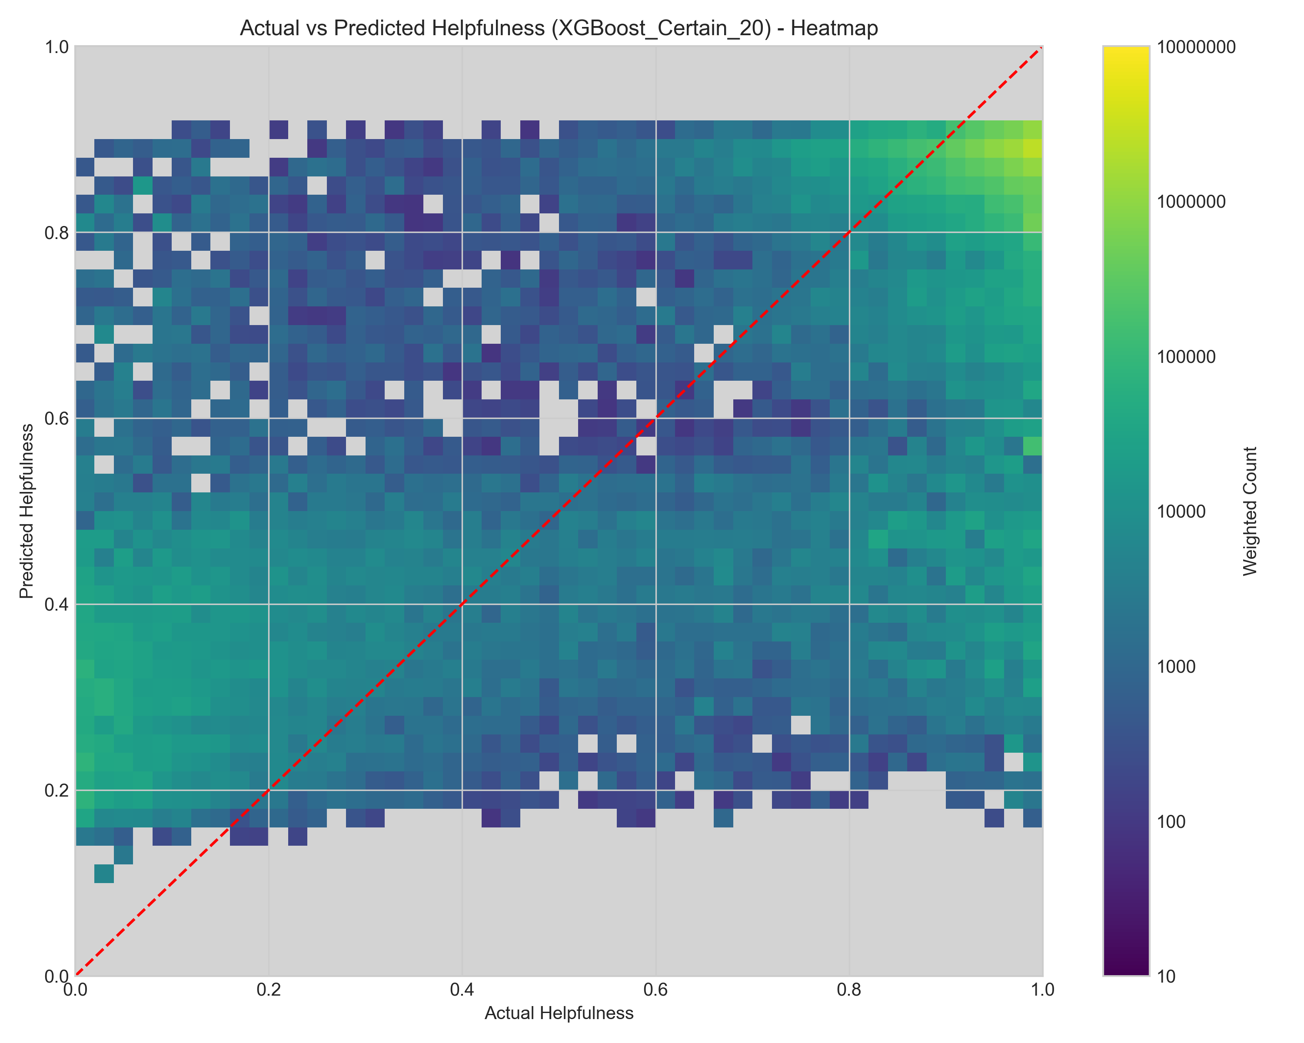
XGBOOST
Results

Slide 39
Full Dataset
Results

Slide 40
Certain twenty
Results

Slide 41
Neural Network W/ EMPATH
Method
review/length
review/score
sentiment_score
ReLU
Dropout 0.2
ReLU
Dropout 0.2
ReLU
Dropout 0.2
Input
Dense128
Dense256
Dense128

Slide 42
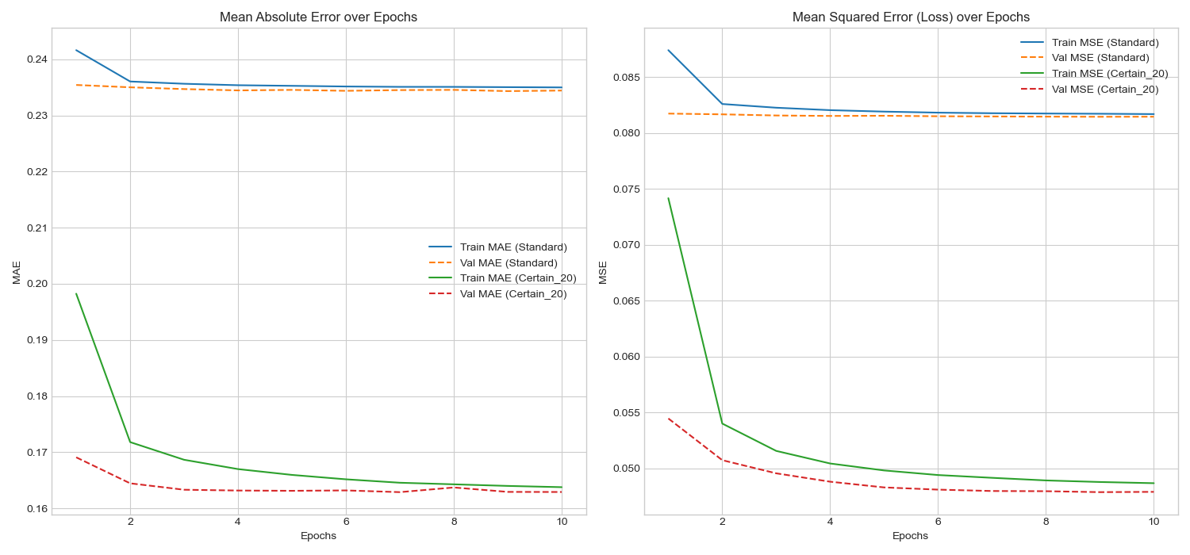
Neural Network W/ EMPATH
Results

Slide 43
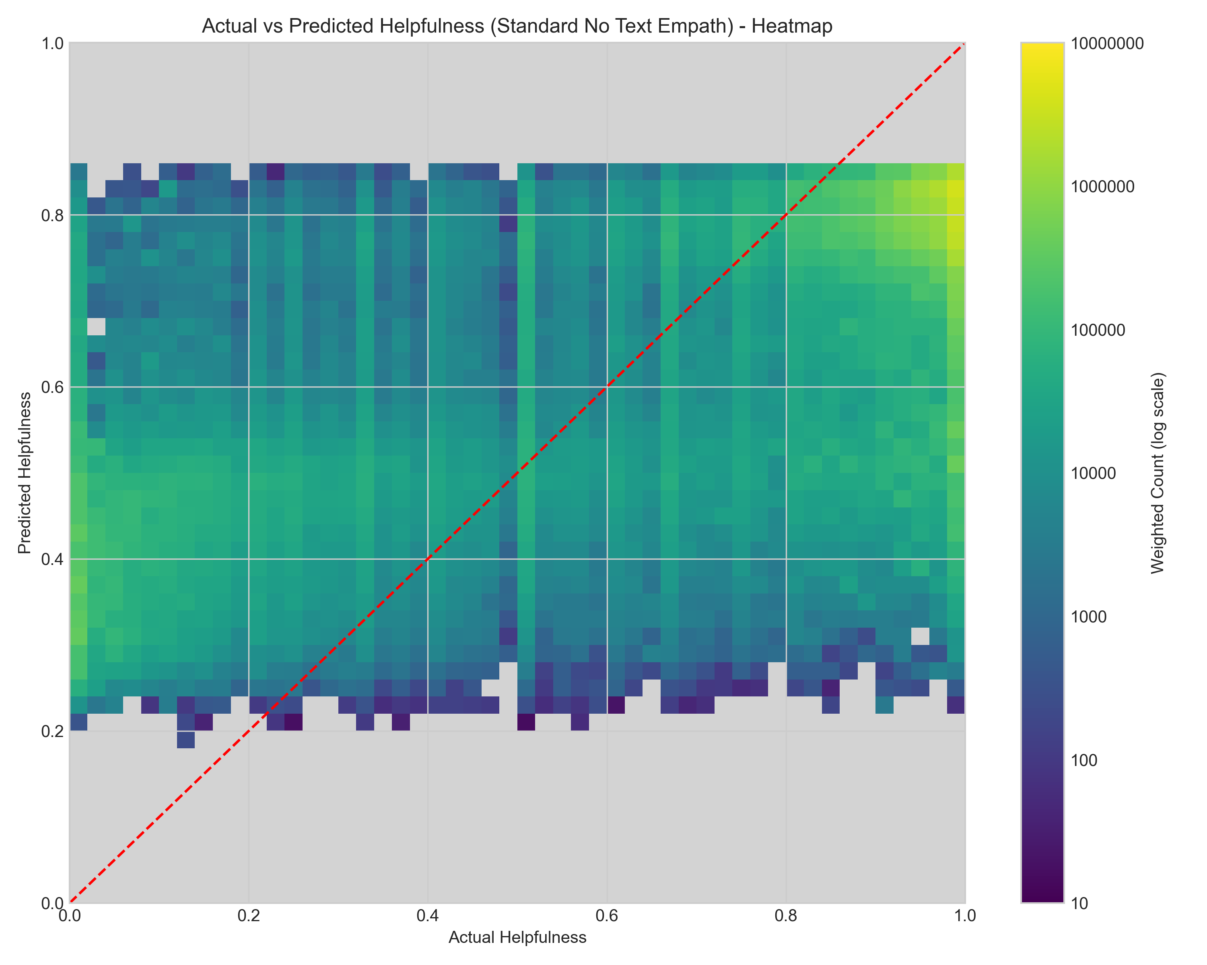
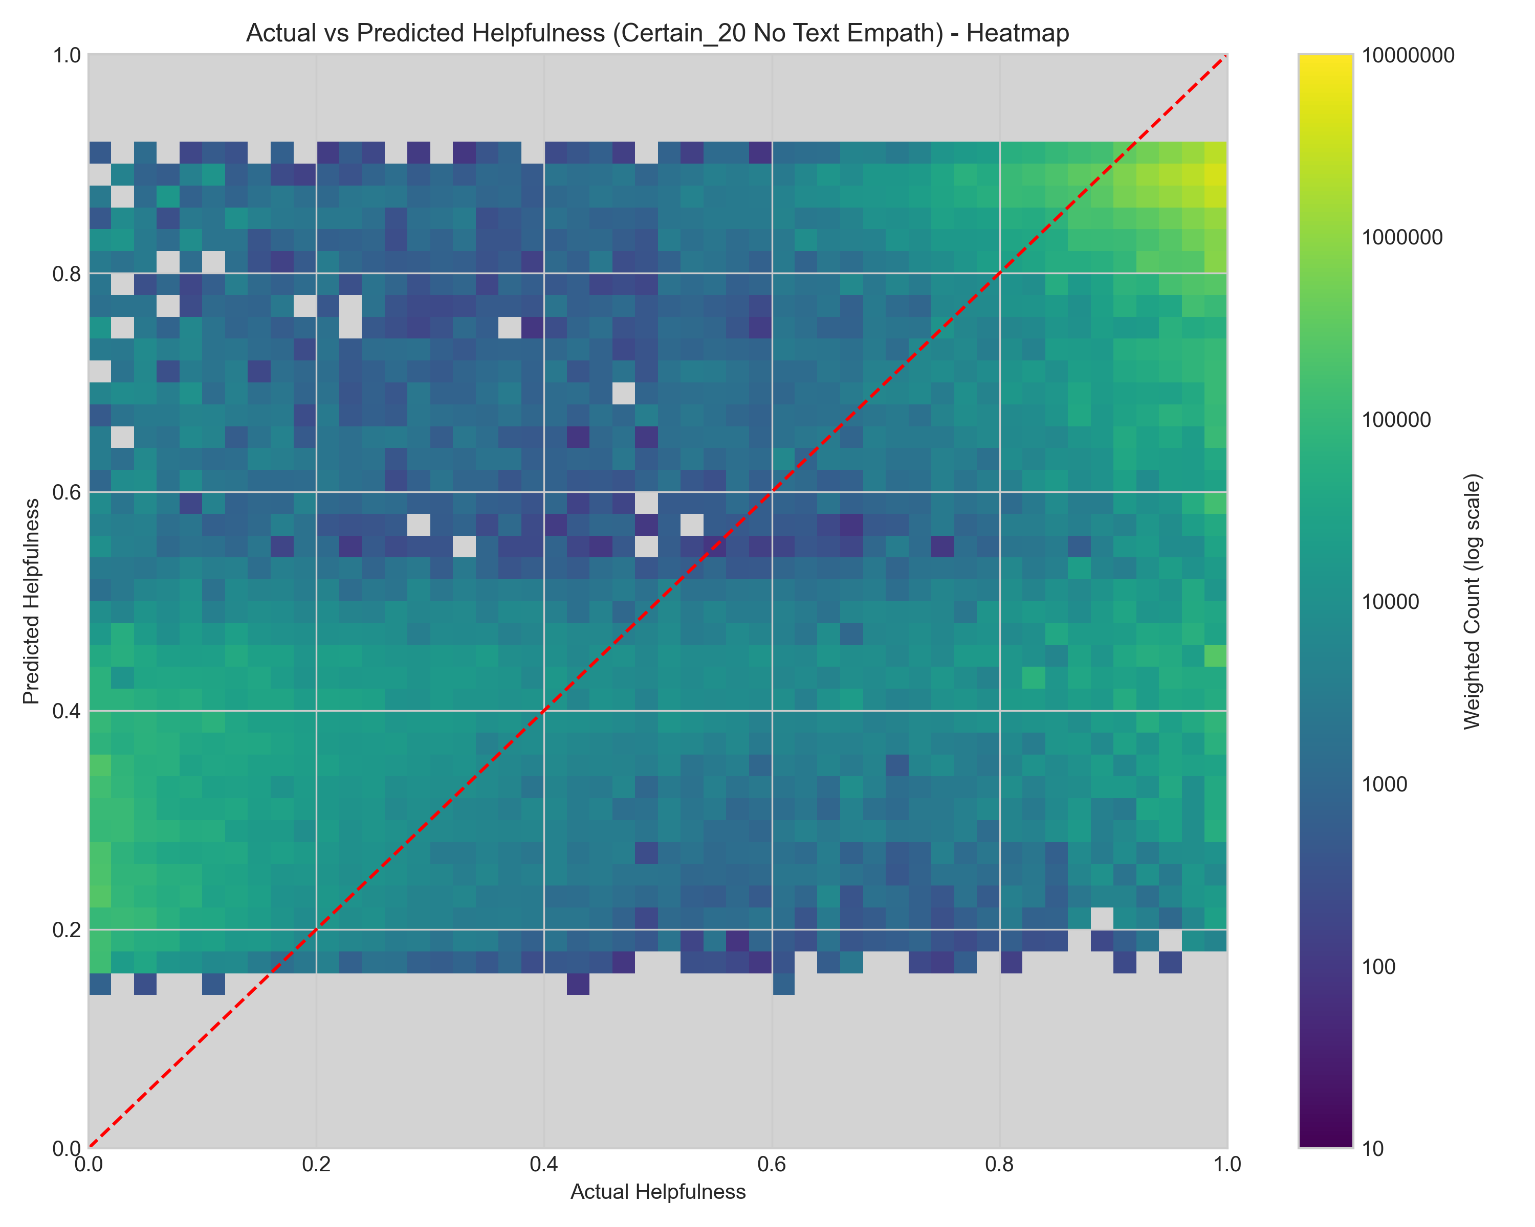
Neural Network W/ EMPATH
Results

Slide 44
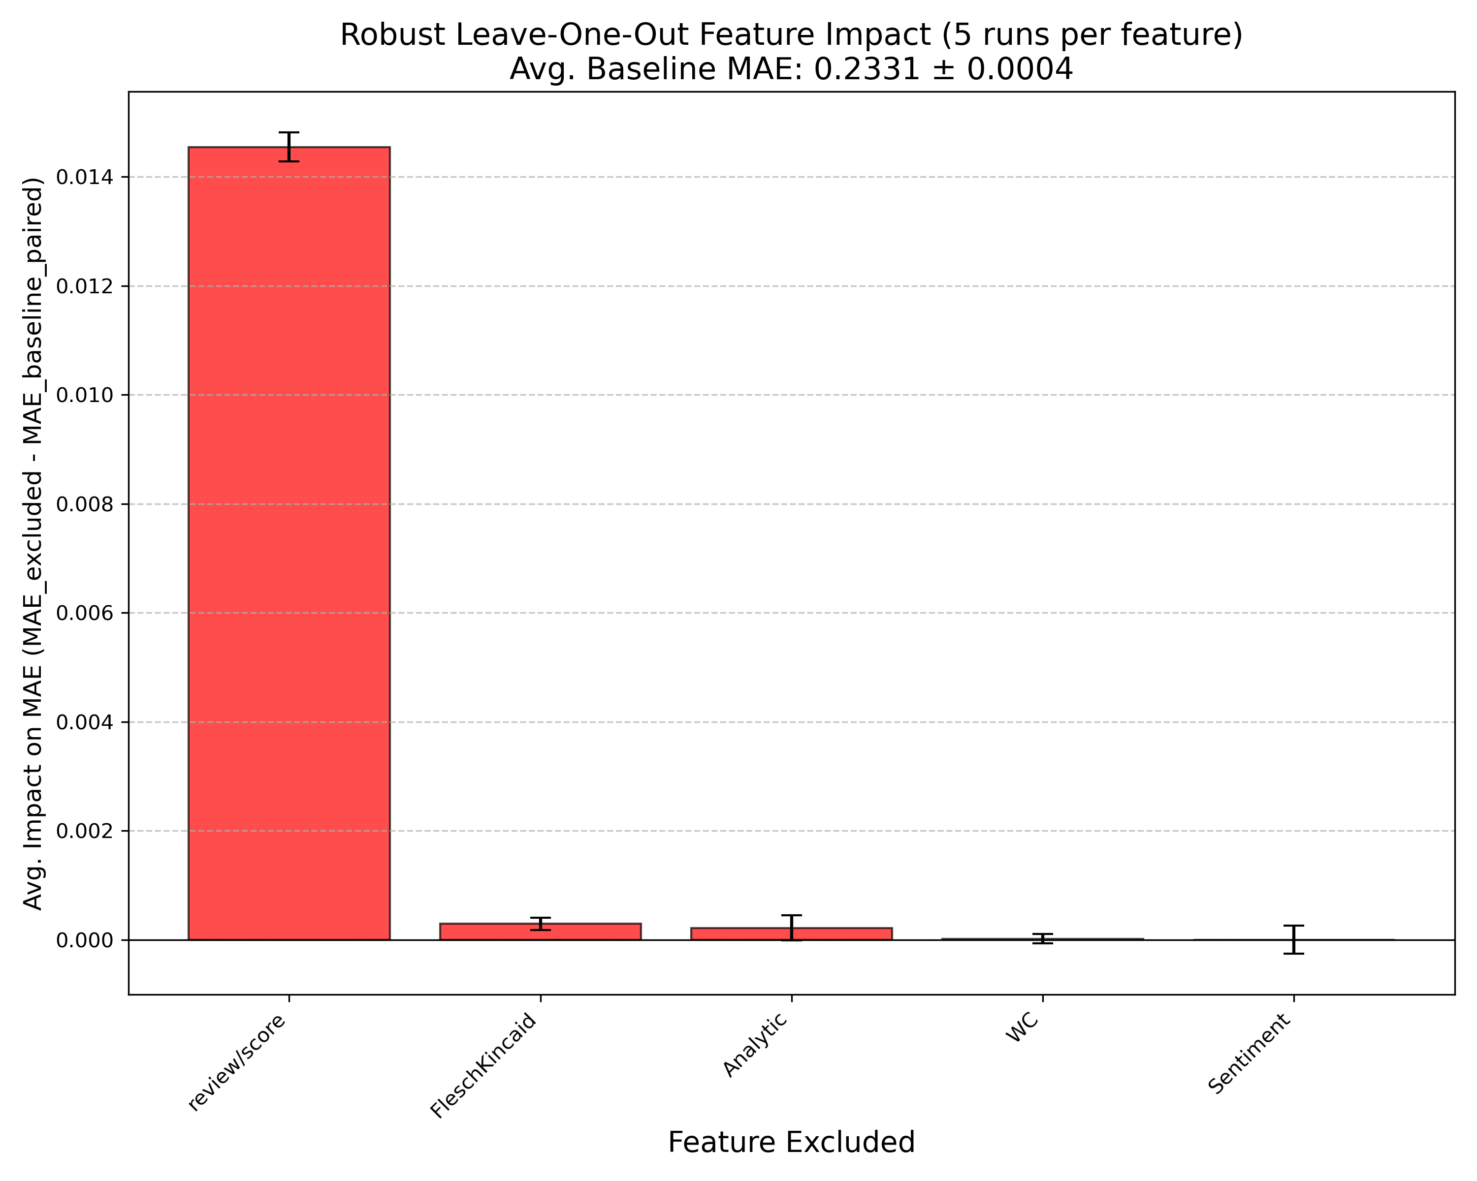
Neural Network W/ EMPATH
Feature Analysis

Slide 45
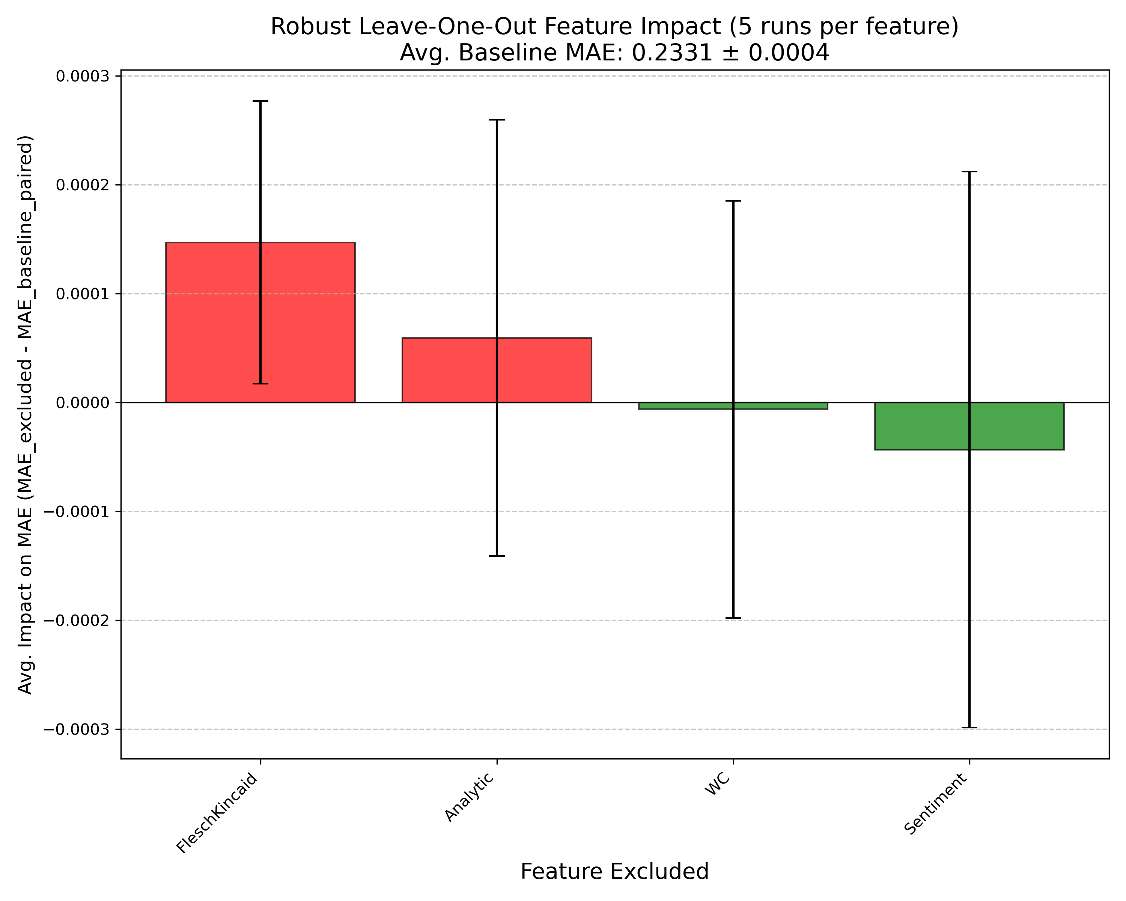
Neural Network W/ EMPATH
Feature Analysis

Slide 46
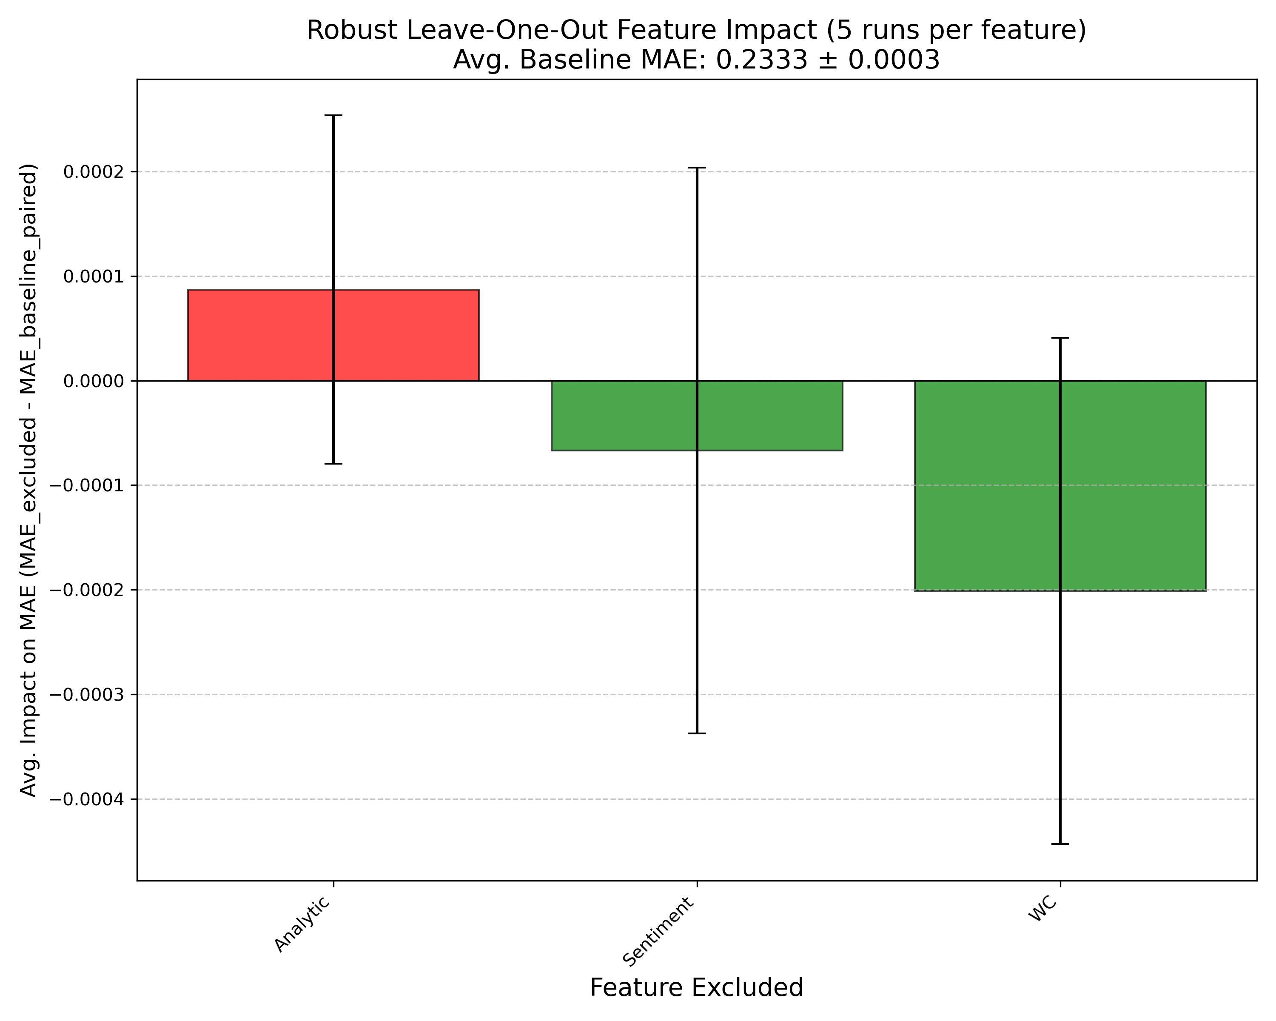
Neural Network W/ EMPATH
Feature Analysis

Slide 47
Full Dataset
Results

Slide 48
Certain twenty
Results

Slide 49
Neural Network w/ Text
Method
review/length
review/score
sentiment_score
ReLU
Dropout 0.2
ReLU
Dropout 0.2
ReLU
Dropout 0.2
Input
Dense128
Dense256
Dense128
review/text

Slide 50
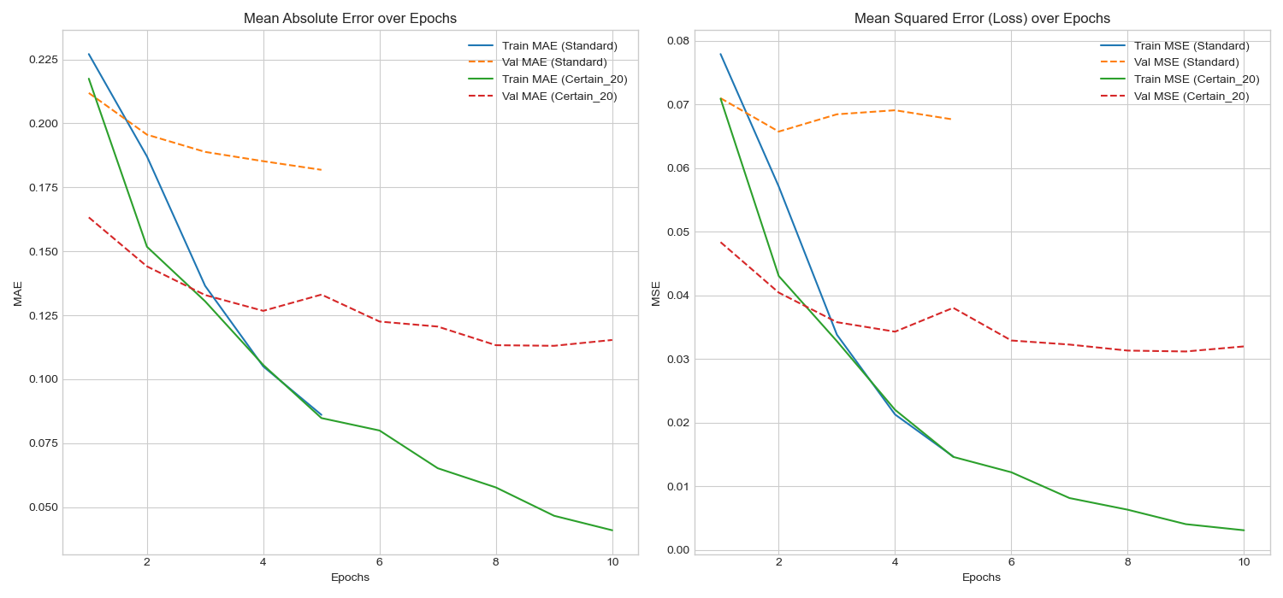
Neural Network w/ Text
Results

Slide 51
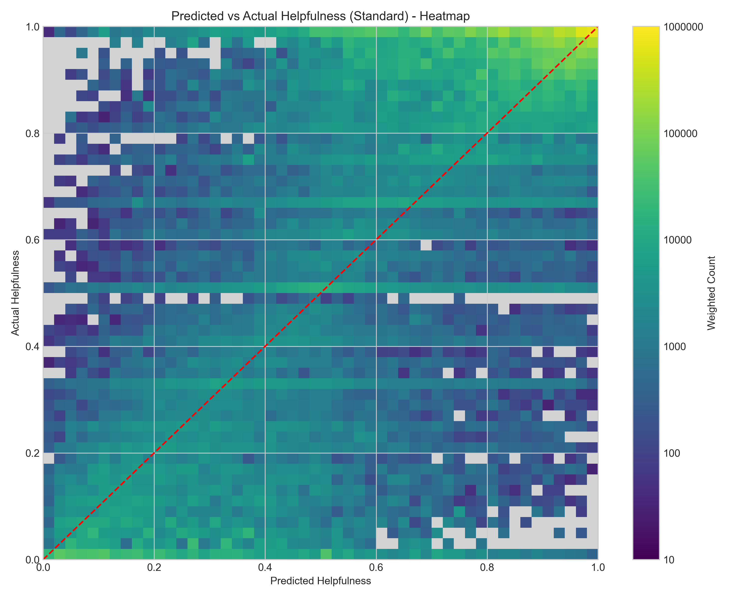
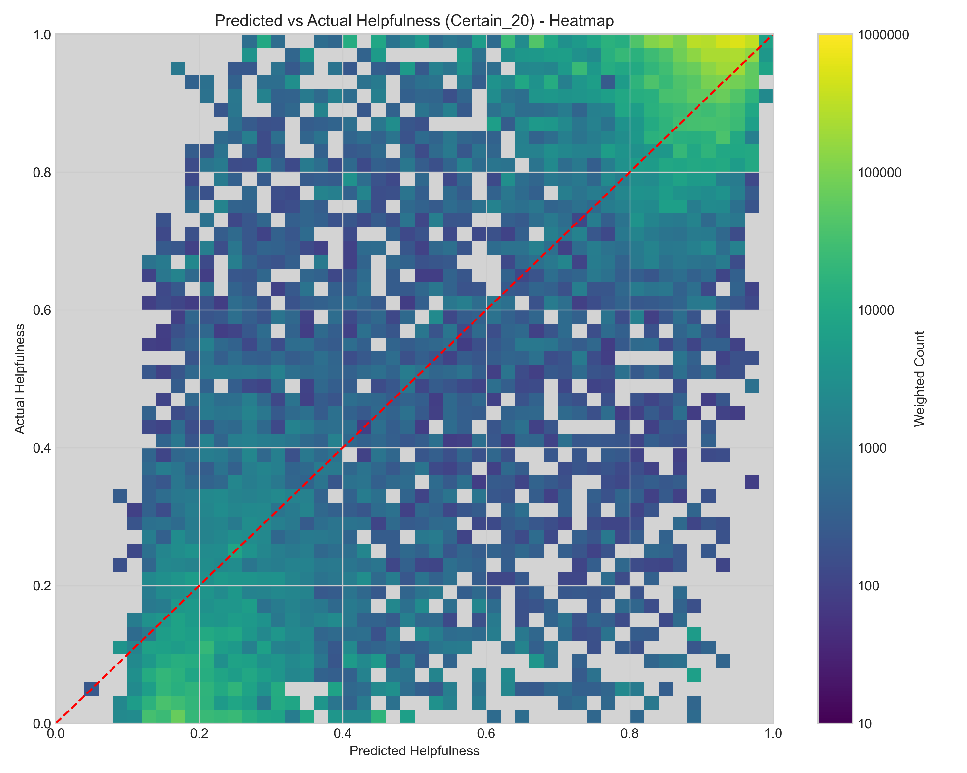
Neural Network W/ Text
Results
Notes:
- Remember to note that axes are transposed here

Slide 52
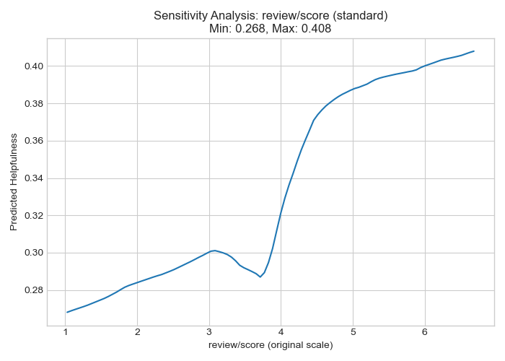
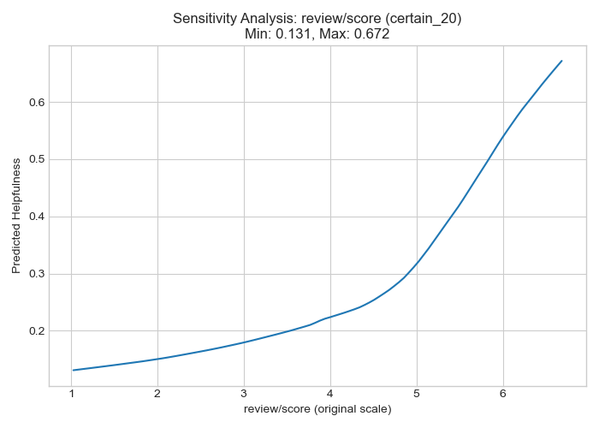
NN W/ Text: Sensitivity Analysis
Review/Score

Slide 53
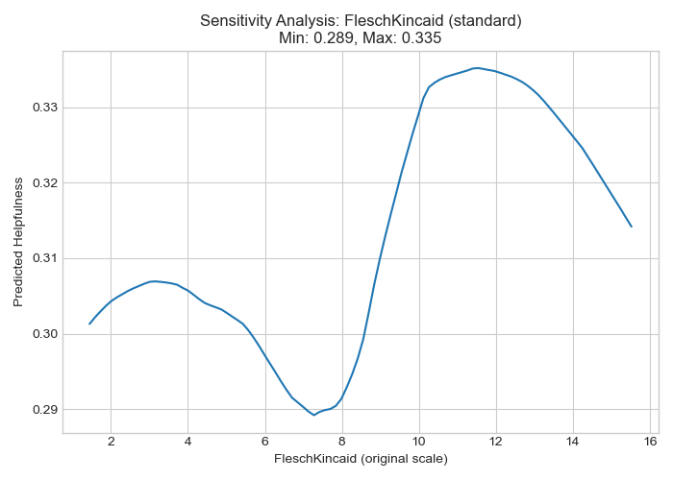
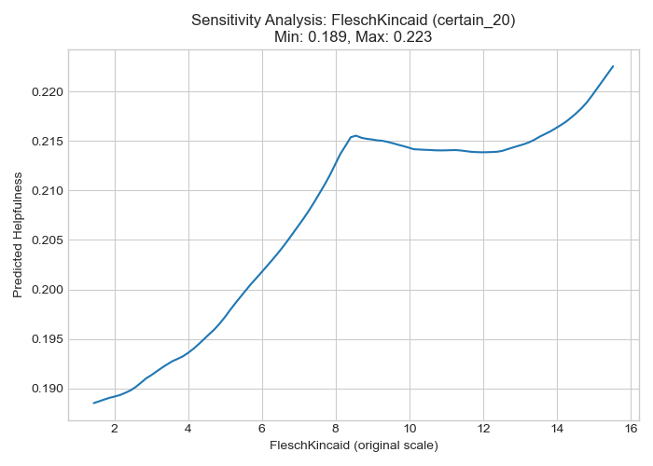
NN W/ Text: Sensitivity Analysis
Fleschkincaid (readability)

Slide 54
Full Dataset
Results

Slide 55
Certain twenty
Results

Slide 56
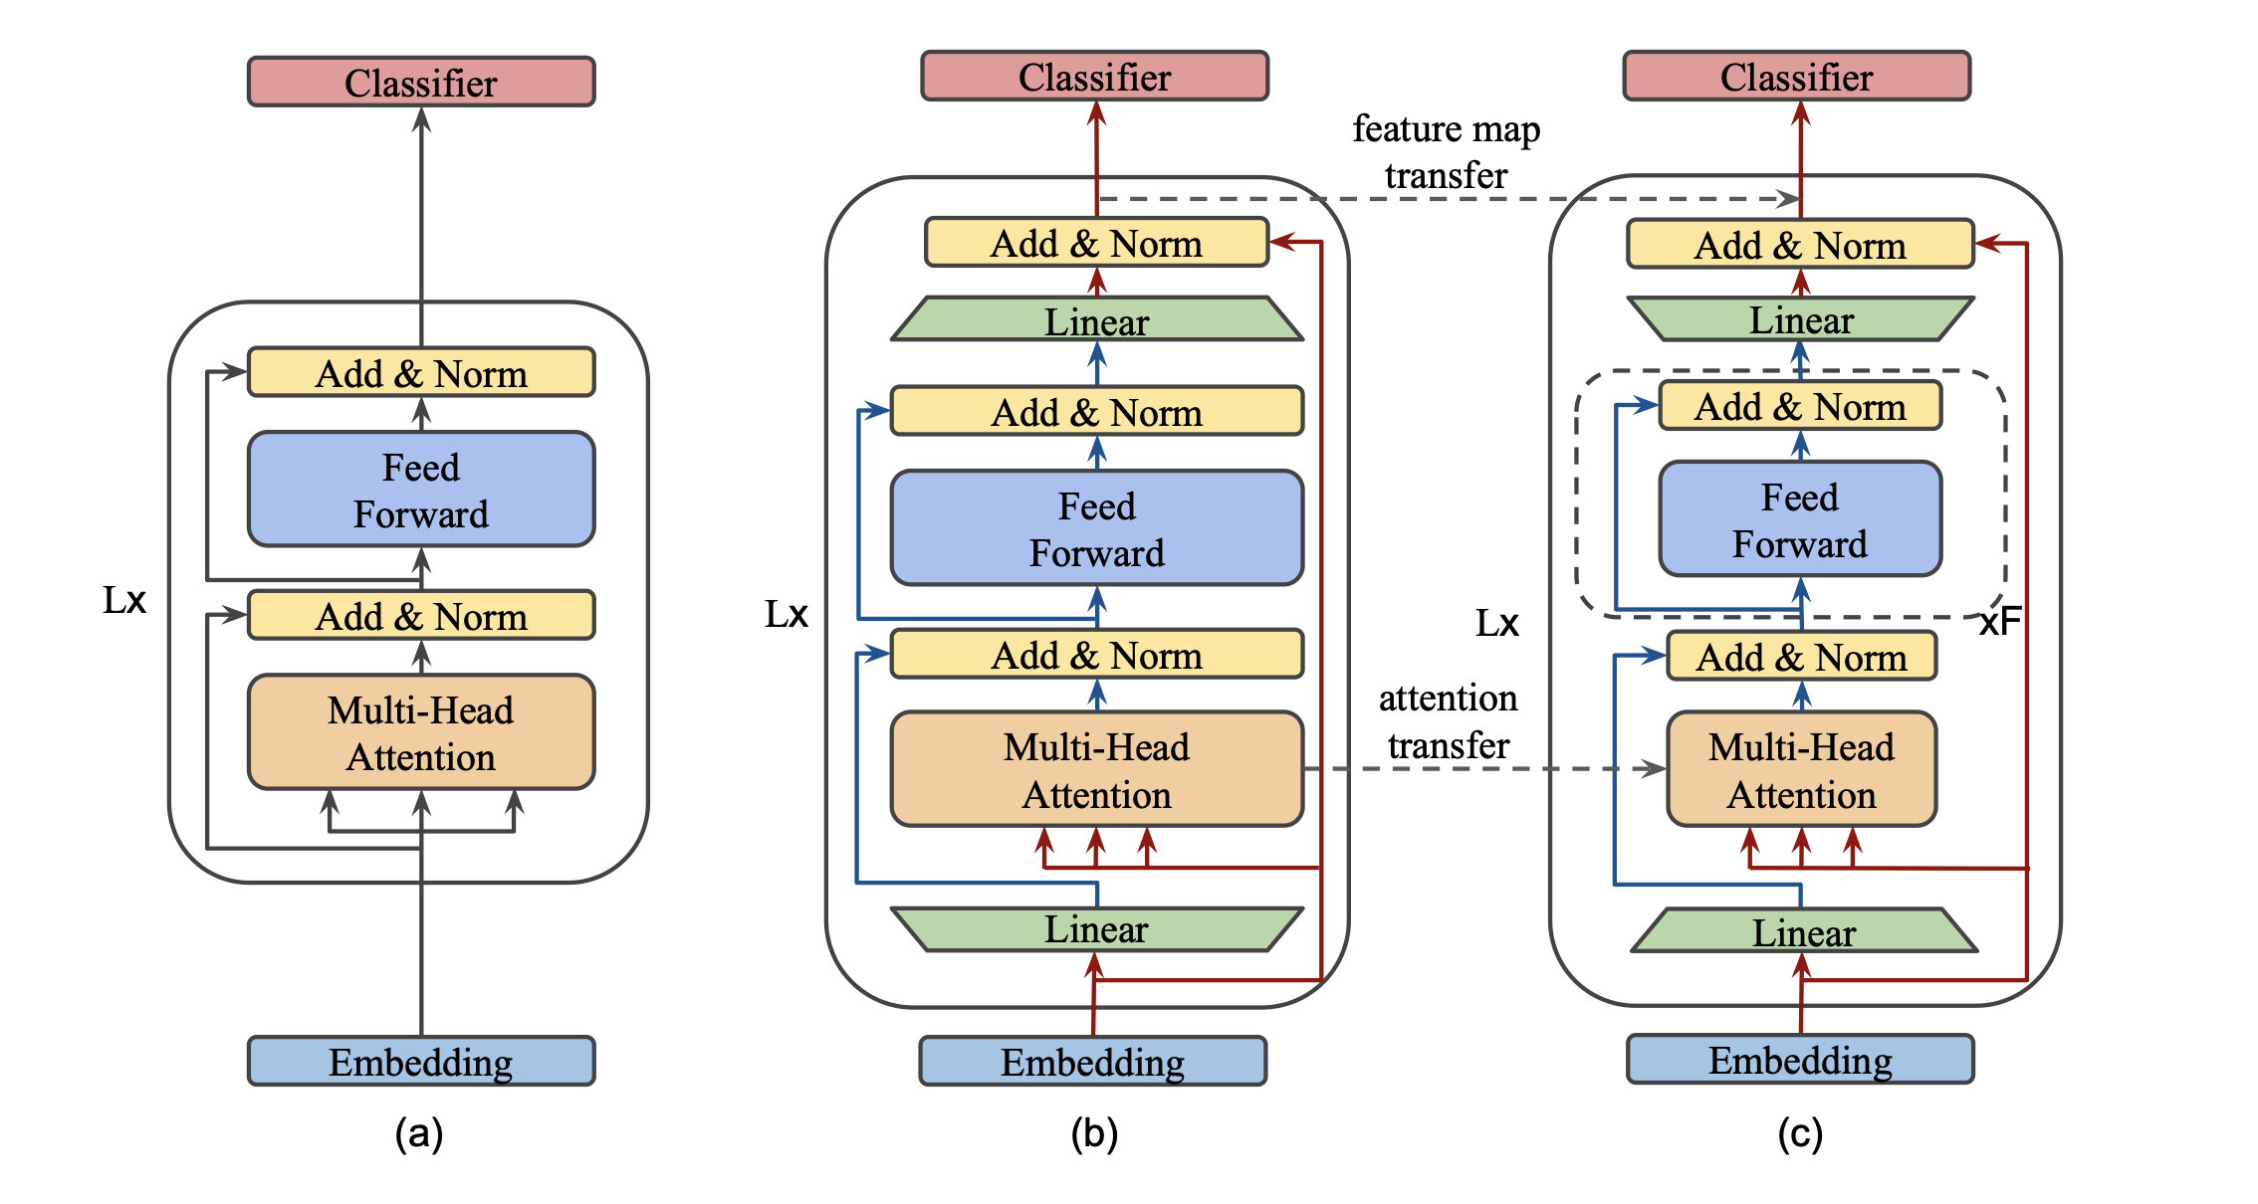
BERT
Method
https://arxiv.org/pdf/2004.02984v2 [9]

Slide 57
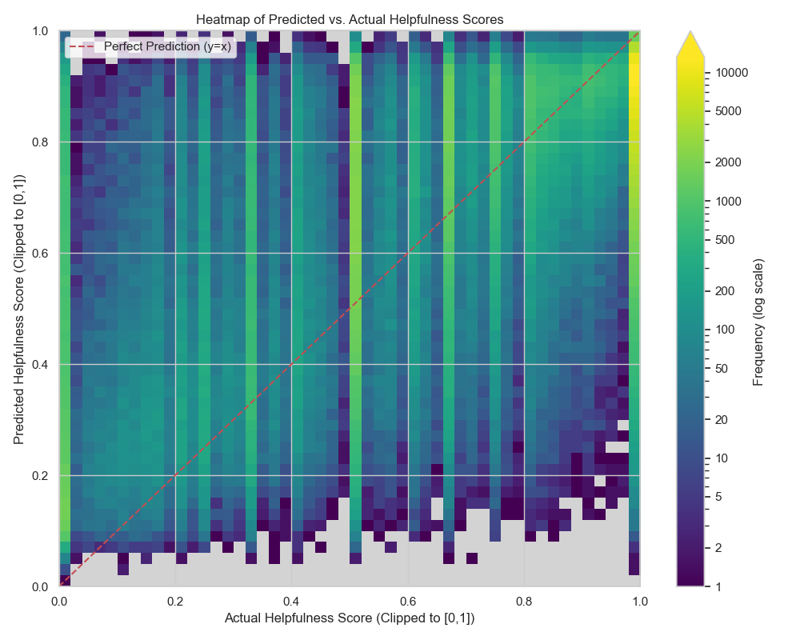
Bert
Results

Slide 58
Full Dataset
Results

Slide 59
Comparison and Discussion
Conclusion

Slide 60
Results Comparison
Other Research
Notes:
- Mention how most other research looks at not just movies, but other categories as well or instead

Slide 61

Discussion
And Limitations
Our results have large MAE / MSE than previous research: however, important to note that this research was conducted on different Amazon Review Data Sets (not movies)
Only NN w/ Text, Quantile Regression, and BERT seem to avoid overfitting at edges
Using a non-weighted Quantile Regression for non-weighted MAE may yield different results
NN w/ Text seems like best model: however, BERT is in close second place, and was only trained on 3% of the data

Slide 62


Future work
BERT was only trained on 3% of the dataset: increasing this will potentially generate better results than NN w/ Text model
Other smoothing methods than Laplace Smoothing could be implemented for the Quantile Regression model: these would likely have the largest effect for the Full Dataset (not Certain 20)
A method could be implemented to help minimise the effect of the popularity-based rankings on Amazon movie products
This investigation could be repeated with a dataset collected closer to the present, as the dataset utilised only runs until 2012

Slide 63
Declaration of Originality
We, Ferdinand Brunne, Oliver King, Brian Funk, and Silvan Metzker, declare that this project is entirely our own piece of work.

Slide 64
References
[1] Y. Park, “Predicting the Helpfulness of Online Customer Reviews across Different Product Types”, Sustainability, vol. 10(6), pp. 1735, May 2018.
[2] World Record Academy, “World's Largest Online Retailer and Marketplace”, https://www.worldrecordacademy.org/2024/11/worlds-largest-online-retailer-and-marketplace-world-record-set-by-amazon-424452, Nov. 2024. [Accessed 11 May 2025]
[3] D. Parris, “The Rise, Fall, and (Slight) Rise of DVDs. A Statistical Analysis”, https://www.statsignificant.com/p/the-rise-fall-and-slight-rise-of, Dec. 2023. [Accessed 11 May 2025]
[4] J. Leskovec, “Web data: Amazon Movie Reviews”, https://snap.stanford.edu/data/web-Movies.html, May. 2013. [Accessed 11 May 2025]
[5] S. Kim et al, “Automatically assessing review helpfulness”, EMNLP '06: Proceedings of the 2006 Conference on Empirical Methods in Natural Language Processing, pp. 423-430, July 2006.
[6] A. Ghose and P. G. Ipeirotis, “Estimating the Helpfulness and Economic Impact of Product Reviews: Mining Text and Reviewer Characteristics”, IEEE Transactions on Knowledge and Data Engineering, vol. 23(10), pp. 1498-1512, Oct. 2011.

Slide 65
References
[7] M. Bilal and A. A. Almazroi, “Effectiveness of Fine-tuned BERT Model in Classification of Helpful and Unhelpful Online Customer Reviews”, Electron Commer Res, vol.23, pp. 2737-2757, Dec. 2023.
[8] T. Chen and C. Guestrin, “XGBoost: A Scalable Tree Boosting System”, https://arxiv.org/abs/1603.02754, Mar. 2016. [Accessed 11/05/2025]
[9] Z. Sun et al, “MobileBERT: a Compact Task-Agnostic BERT for Resource-Limited Devices”, https://arxiv.org/pdf/2004.02984v2, Apr. 2020. [Accessed 11/05/2025]
[10] K. M. Shannon, “Predicting Amazon Review Helpfulness Ratio”, https://www.researchgate.net/publication/317578901_Predicting_Amazon_Review_Helpfulness_Ratio, June 2017. [Accessed 11/05/2025]
[11] F. Hjalmarsson, “Predicting the Helpfulness of Online Product Reviews”, https://www.diva-portal.org/smash/get/diva2:1595730/FULLTEXT02.pdf, Sept. 2021. [Accessed 11/05/2025]

Slide 66

Thank you for listening
Any Questions

Slide 67
EXTRA SLIDES

Slide 68
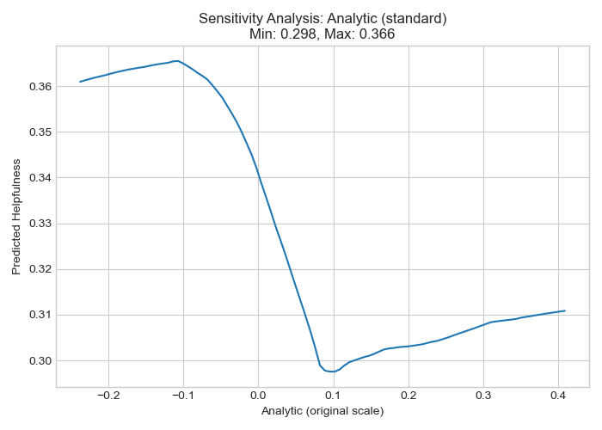
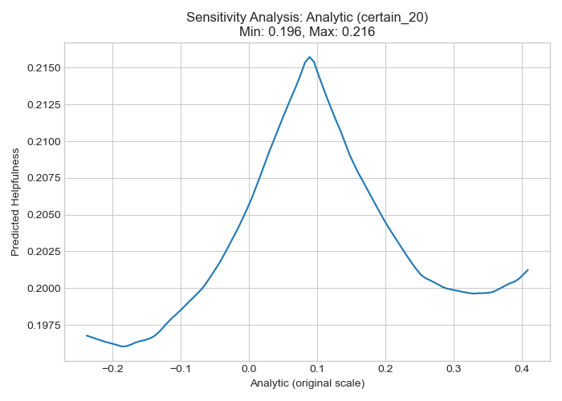
Analysis
Analytic

Slide 69
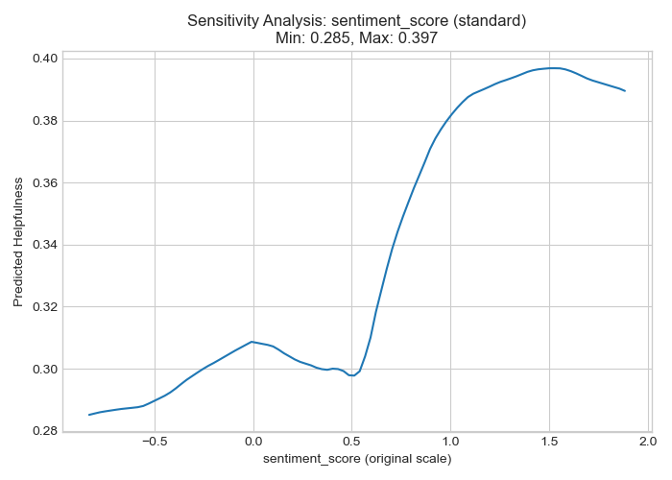
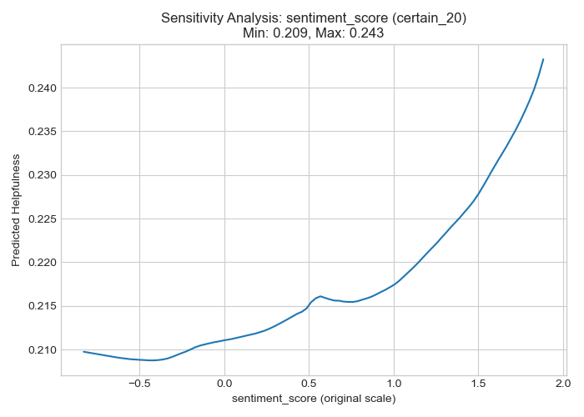
Analysis
sentiment score

Slide 70
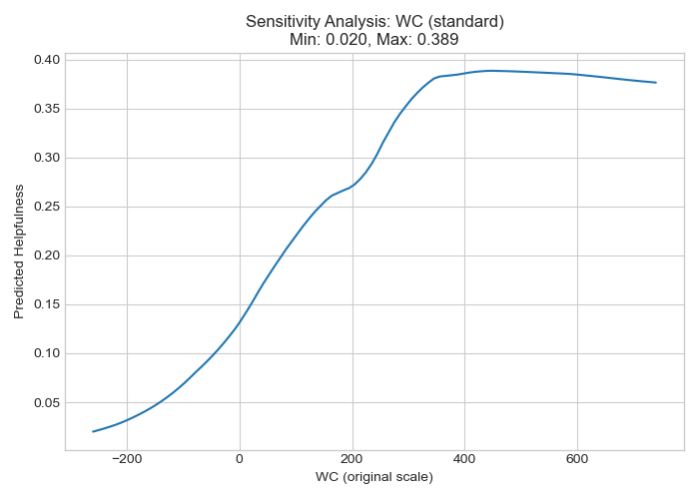
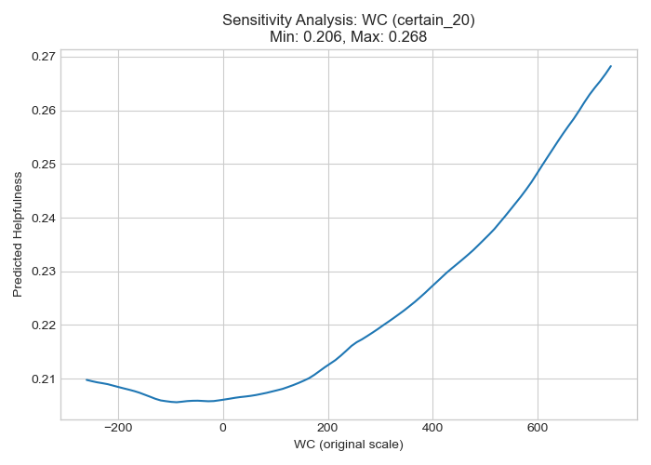
Analysis
word count

Slide 71
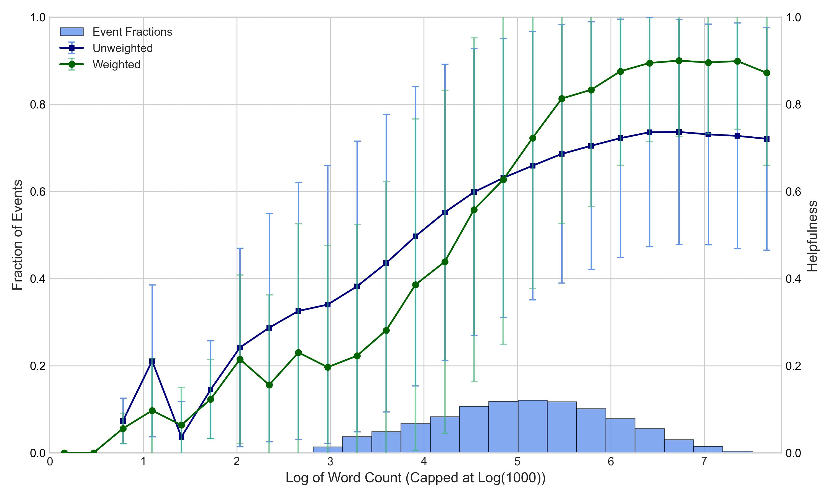
EDA: Log(Word Count)

Slide 72
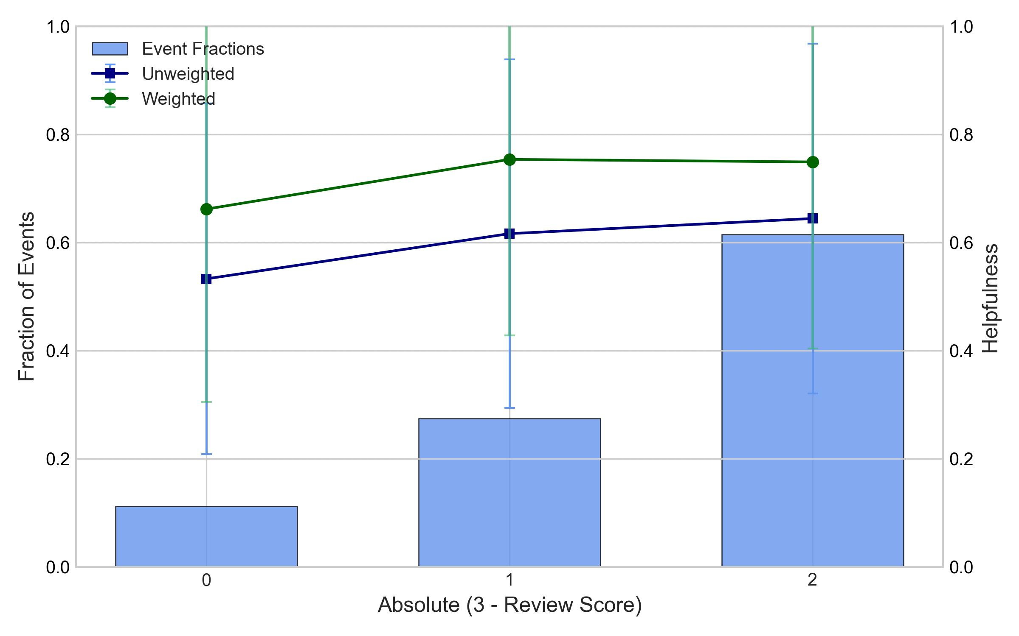
EDA: Abs(three - rating)

Slide 73
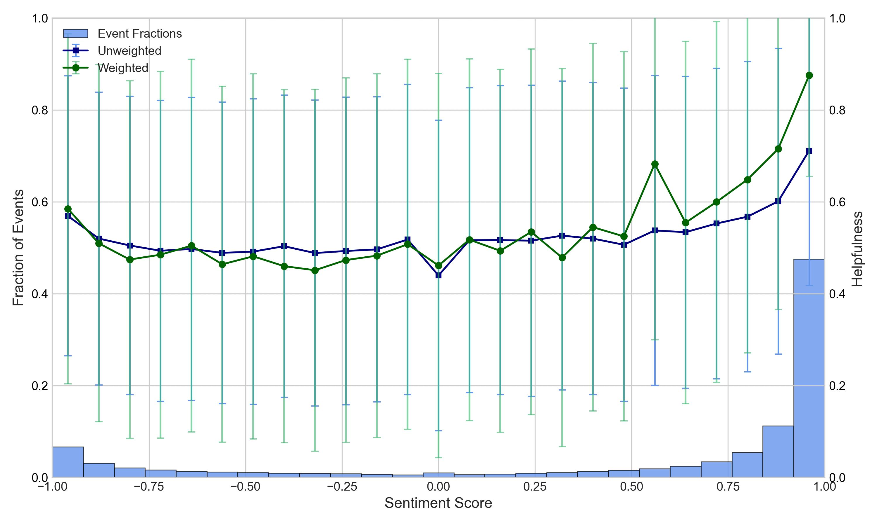
EDA: Sentiment

Slide 74
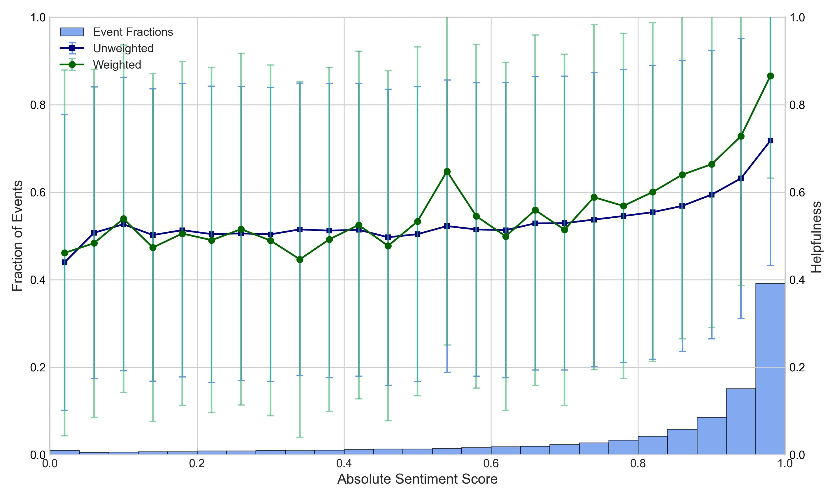
EDA: Abs(Sentiment)

Slide 75
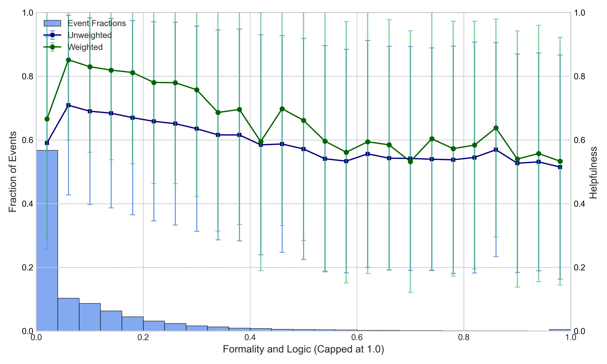
EDA: Analytic

Slide 76
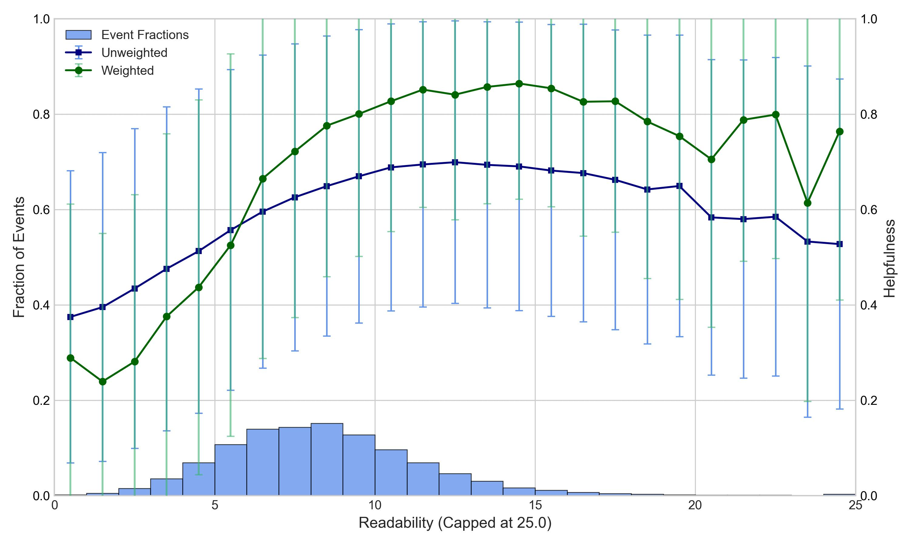
EDA: Readability

Slide 77
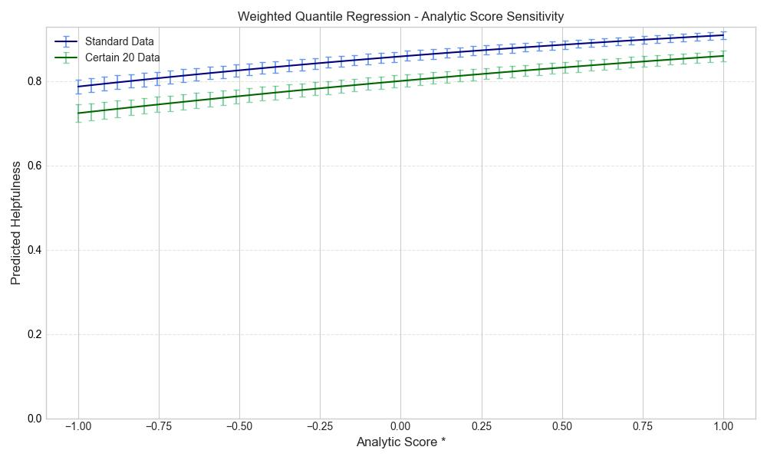
QUANTILE REGRESSION
Sensitivity Analysis

Slide 78
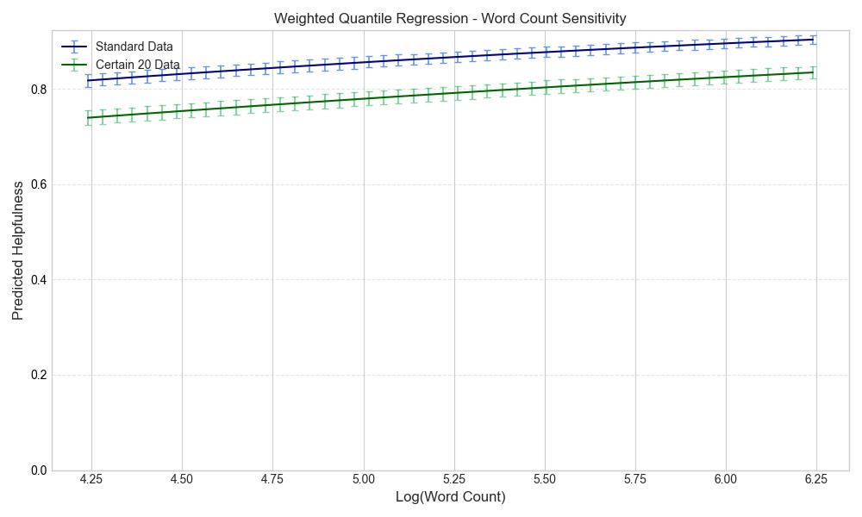
QUANTILE REGRESSION
Sensitivity Analysis

Slide 79
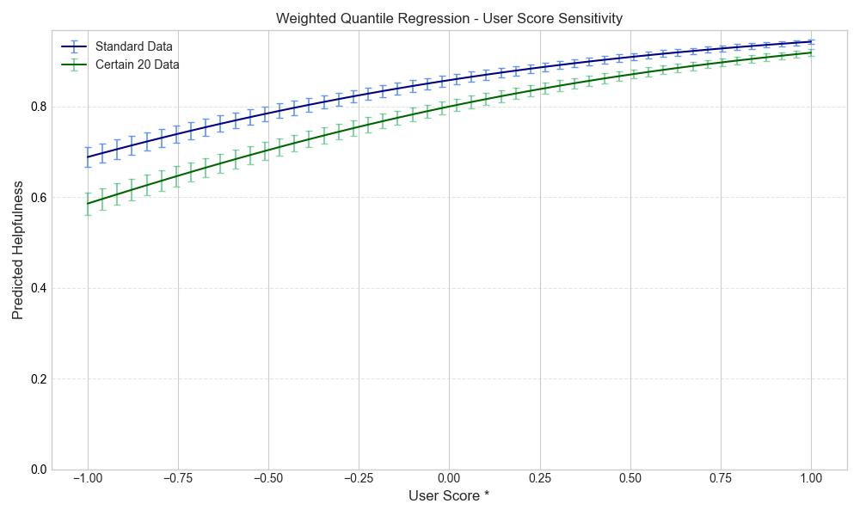
QUANTILE REGRESSION
Sensitivity Analysis

Slide 80
Neural Network
Method
review/length
review/score
sentiment_score
ReLU
Dropout 0.2
ReLU
Dropout 0.2
ReLU
Dropout 0.2
Input
Dense64
Dense128
Dense64

Slide 81
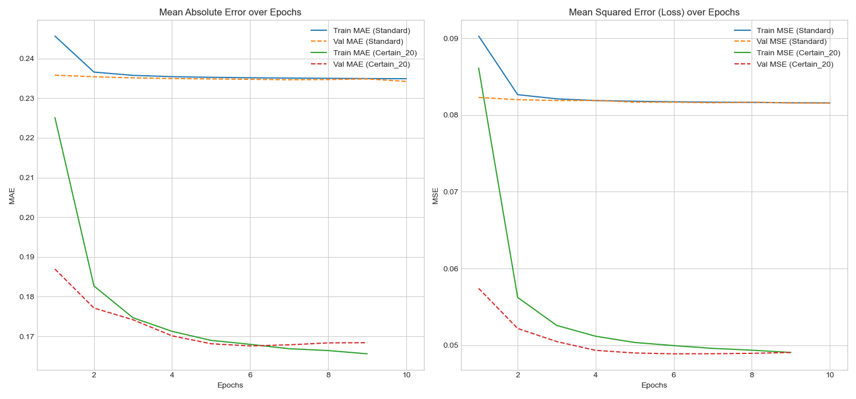
Neural Network
Results

Slide 82
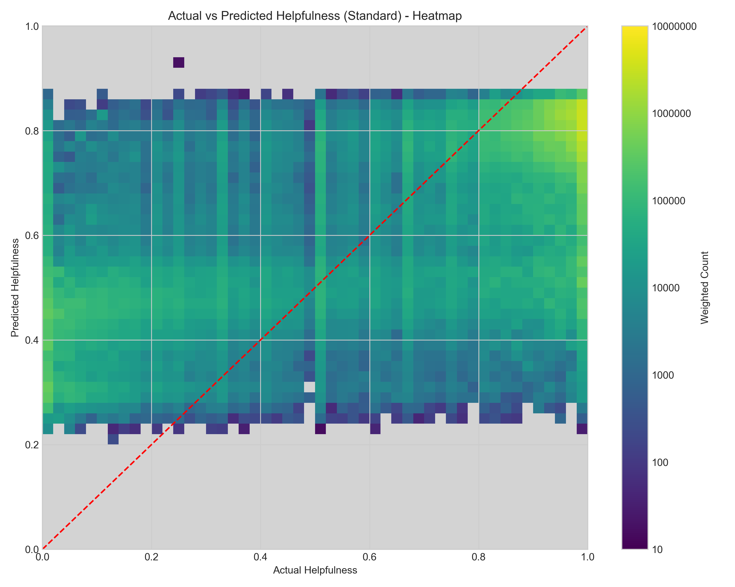

Neural Network
Results

